Slide 1
FUNNEL ANALYSIS presentation
GARY NGUYEN

Slide 2
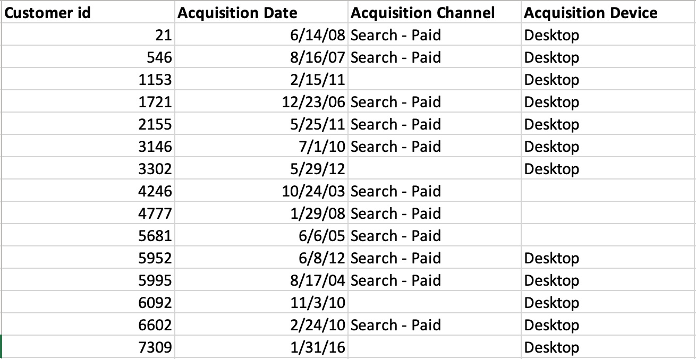
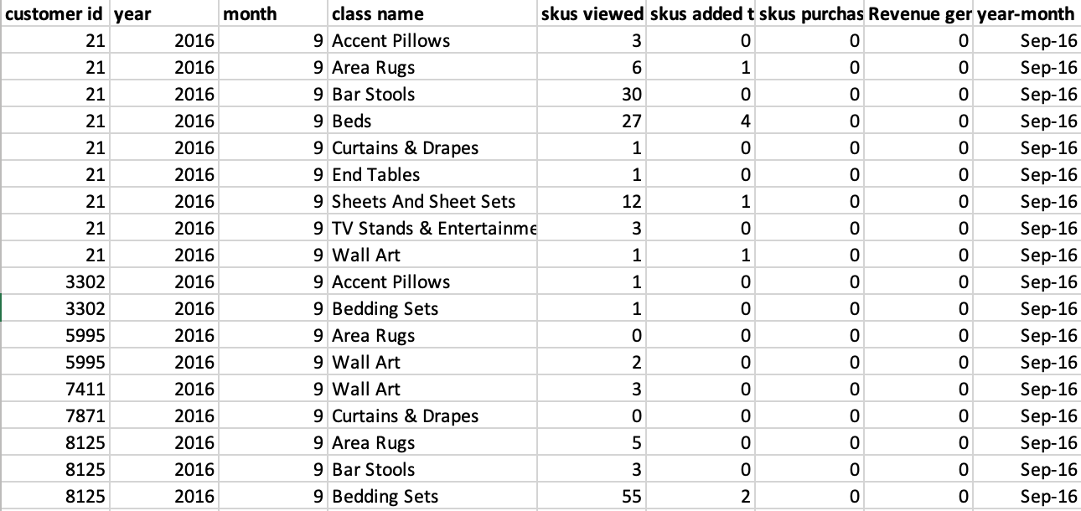
THE DATA
CUSTOMER ACQUISITION DATA
(1,402 rows for 1,383 unique customers, acquired from Sep-02 to Jun-16)
FUNNEL DATA FOR SKU CLASSES
(10,000 rows for 1,387 customers, from Sep-16 to Aug-18)

Slide 3
Data processing steps
For customer acquisition data:
There are 18 duplicate customer IDs. To resolve this, I only selected the earliest customer ID for each customer and removed all other duplicate entries.
For customer ID without an acquisition channel or acquisition device, I replaced the NULL values with “Unknown” for data analysis and visualization.

Slide 4
OUTLINE
1. CUSTOMER ACQUISITION ANALYSIS
2. SKU CLASS ANALYSIS
3. FUNNEL ANALYSIS

Slide 5
1. Customer acquisition analysis

Slide 6
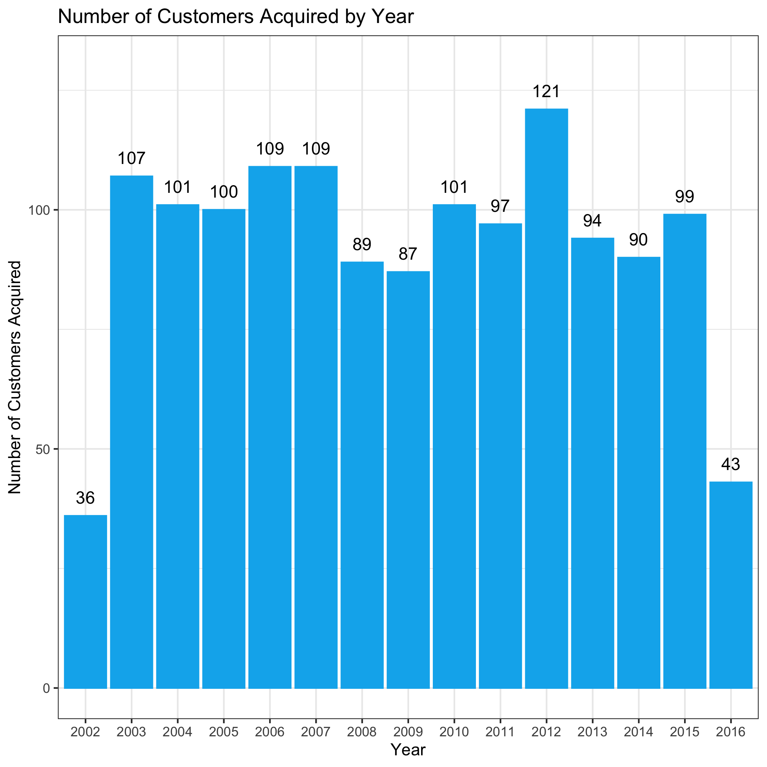
We have 1,383 unique customers. NUMBER OF CUSTOMERS ACQUIRED IS relatively stable THROUGH THE YEARS.
The number of newly acquired customers is relatively stable over the years, peaking at 121 new customer in 2012.
The is a slight decreasing trend in terms of new customers in recent years (from 2013 to 2015).
Note: We only have data for the last 4 months of 2002, and the first 6 months of 2016.

Slide 7
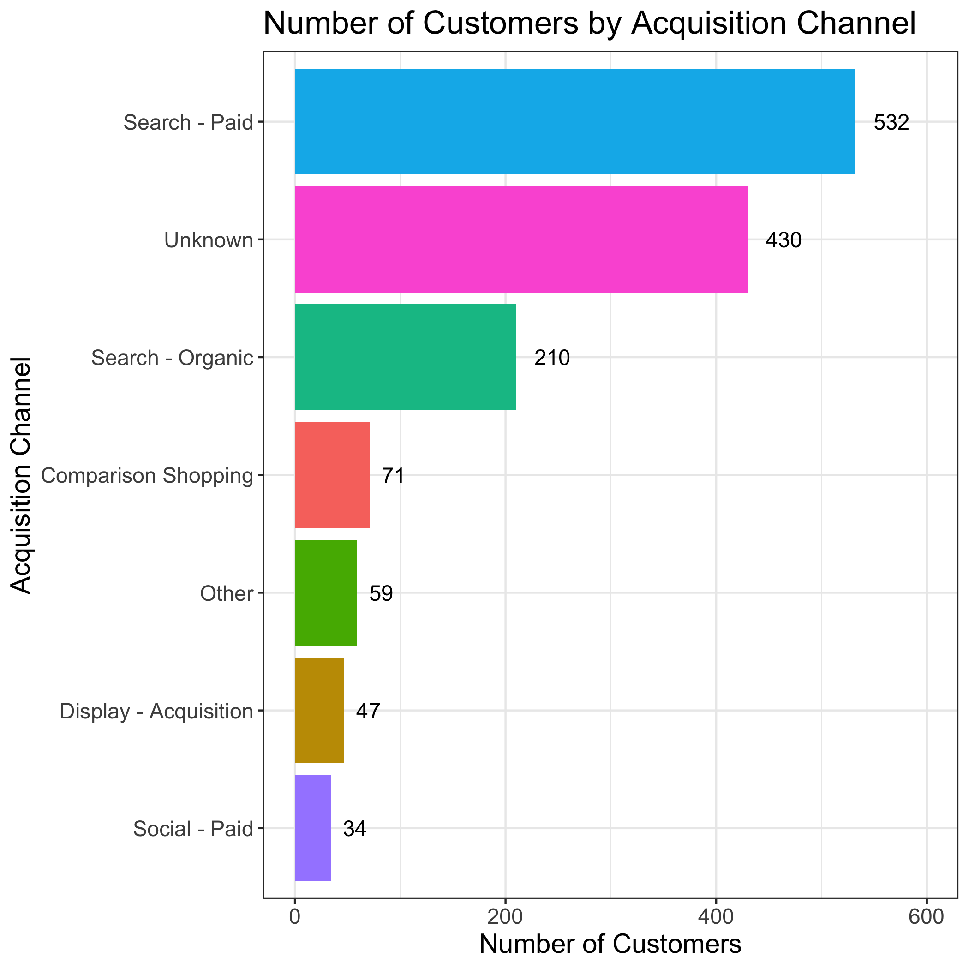
Paid search has the highest number of customers acquired
We don't know the acquisition channel of 430 (or 31.09%) customers. Among the customers with an acquisition channel, 532 (38.47%) customers are from Paid Search, 210 (15.18%) are from Organic Search. Paid Social and Display – Acquisition have the fewest customers acquired (47 and 34, respectively).

Slide 8
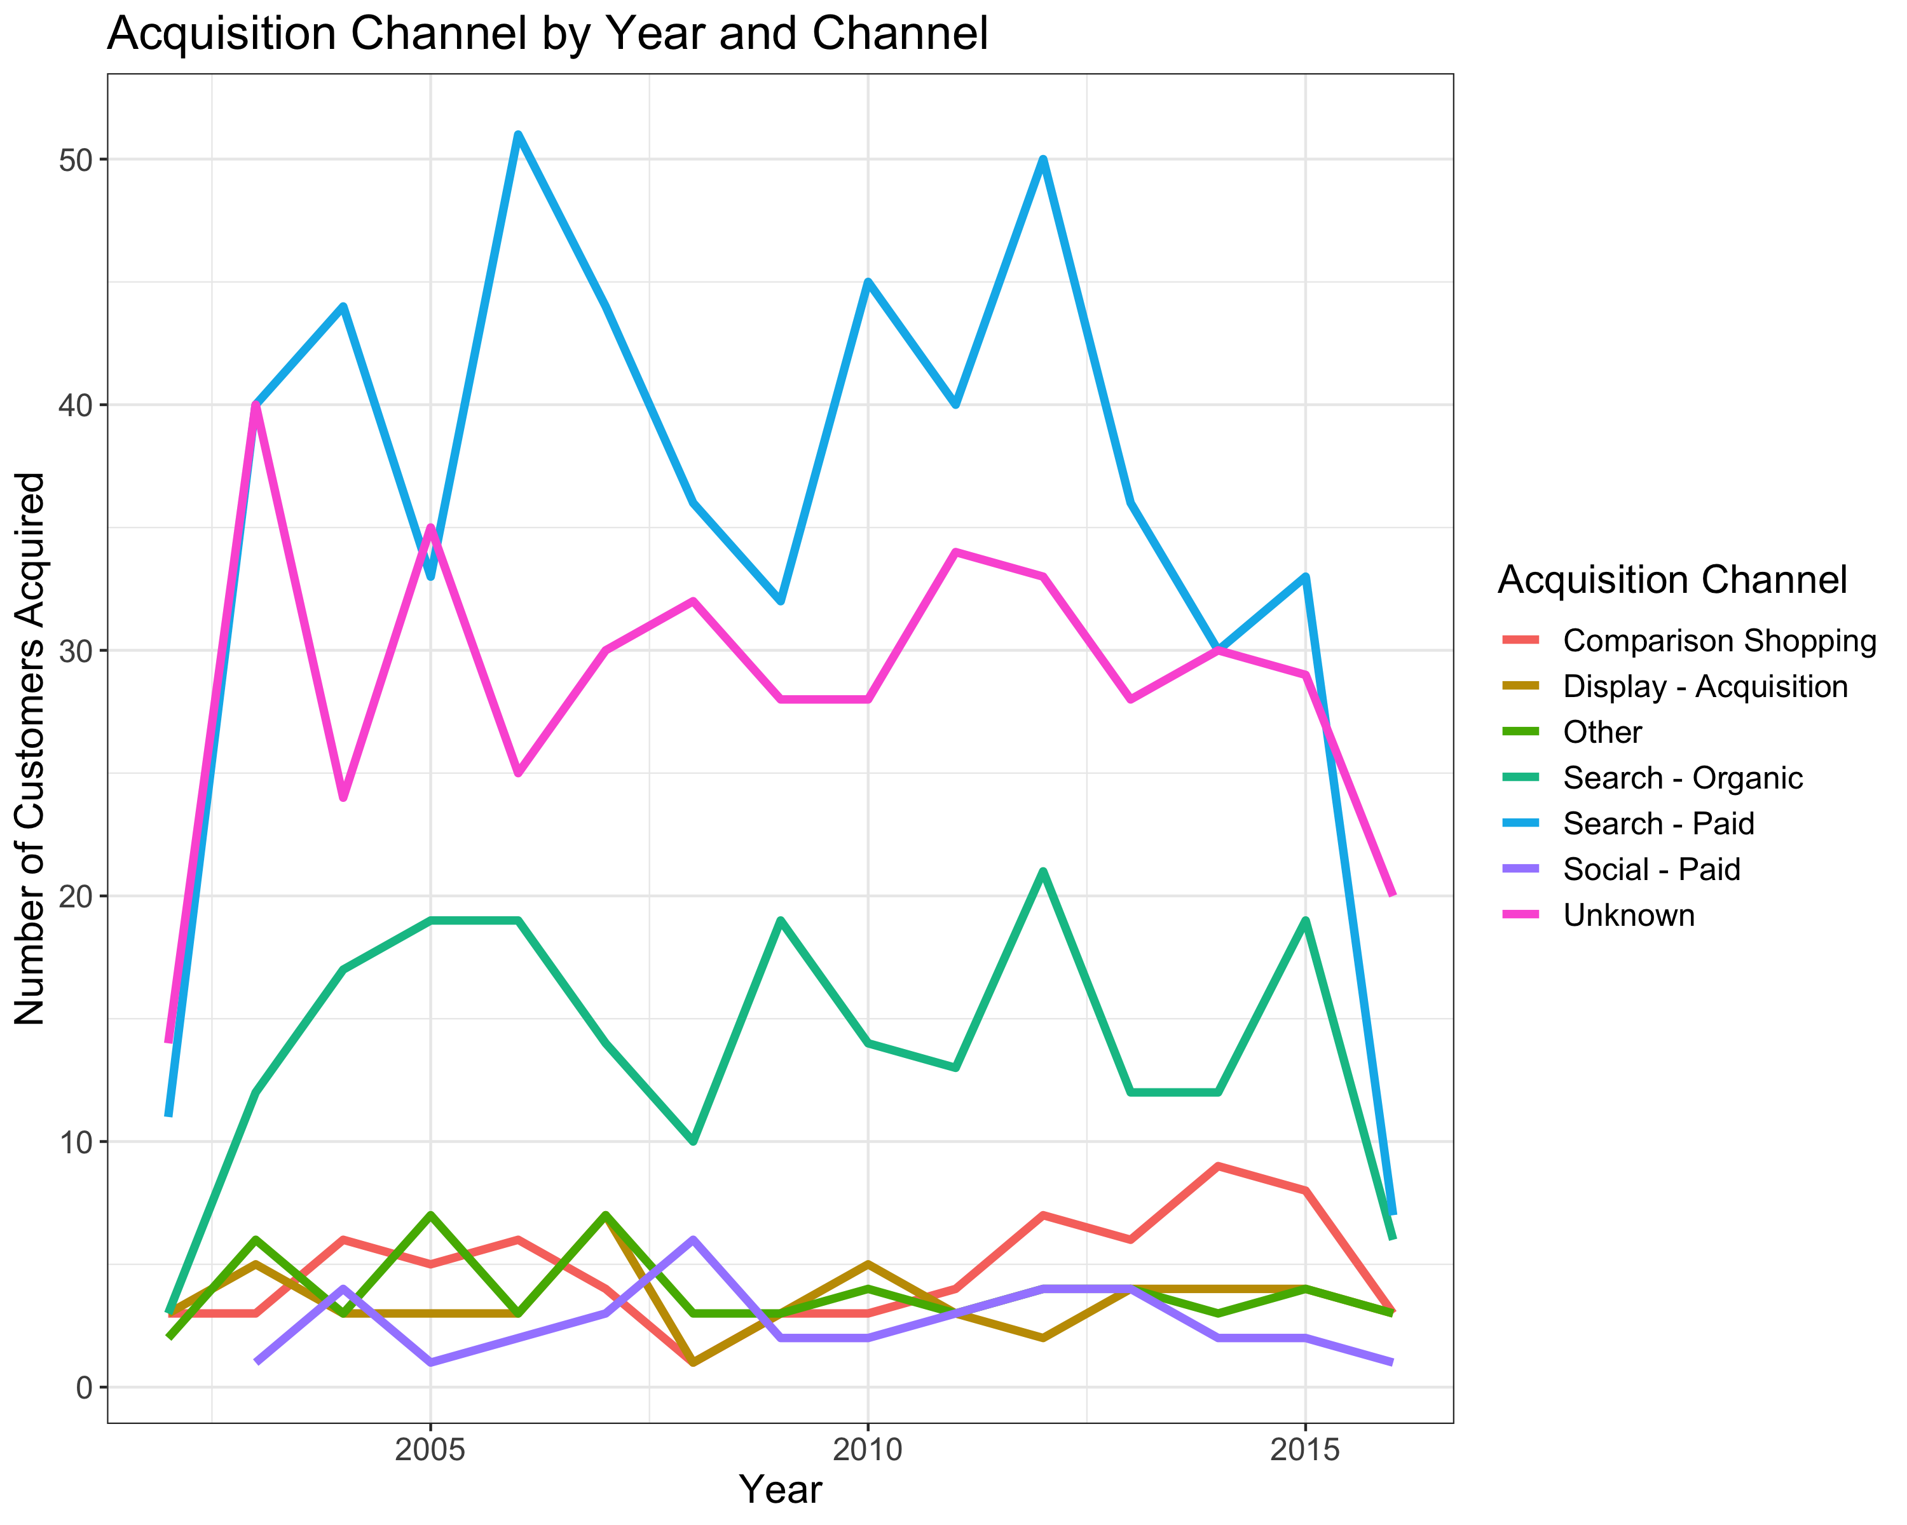
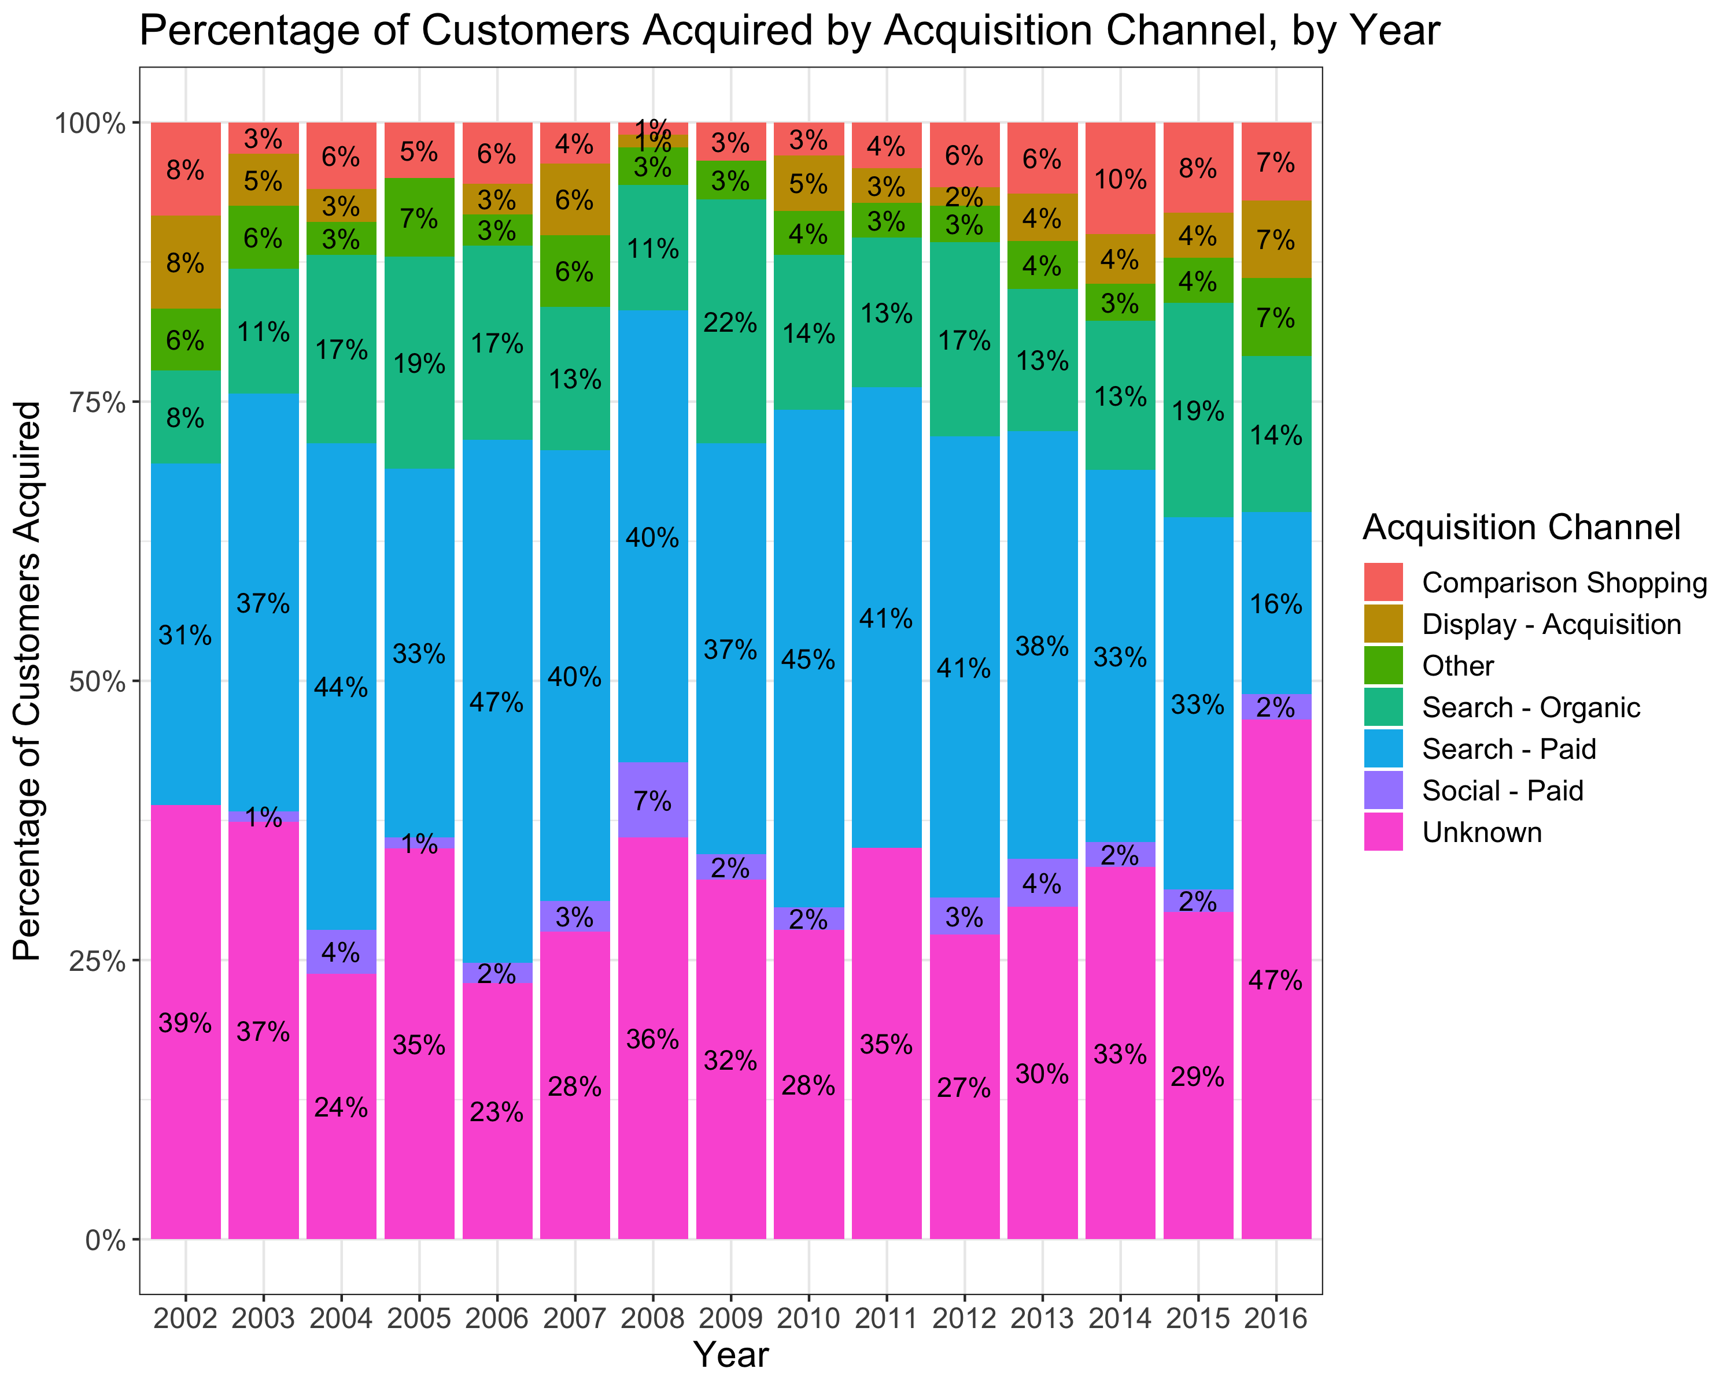
Paid Search and Organic Search are consistently the #1 and #3 channel in terms of new customers acquired. WE ALSO SEE AN INCREASE IN PERCENTAGES FROM COMPARISON SHOPPING, AND DECREASE IN PERCENTAGES FROM PAID SEARCH.

Slide 9
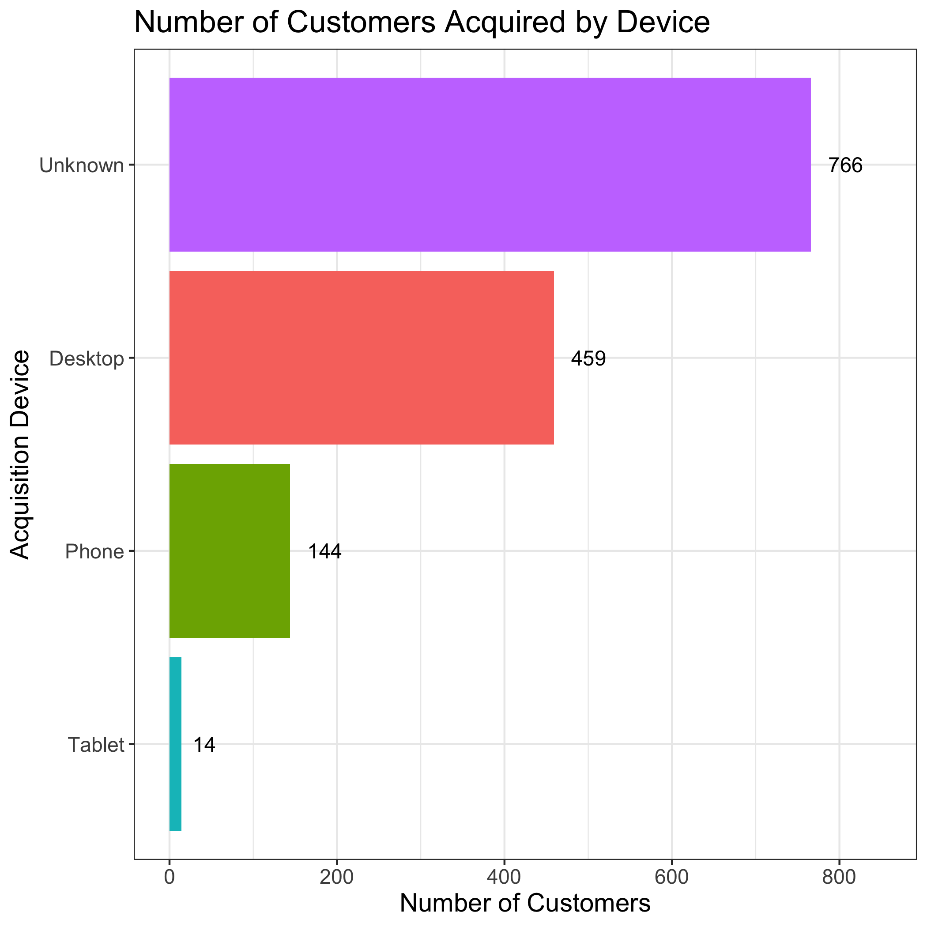
THE MAJORITY OF CUSTOMERS WITH KNOWN ACQUISITION DEVICE COME FROM DESKTOP
Out of 1,383 customers, we don't know the acquisition device of 766 (or 55.38%) customers.
Among the customers with an acquisition device, 459 (33.18%) customers are from Desktop, 144 (10.41%) customers are from Phone and only 14 (1.01%) are from Tablet.

Slide 10
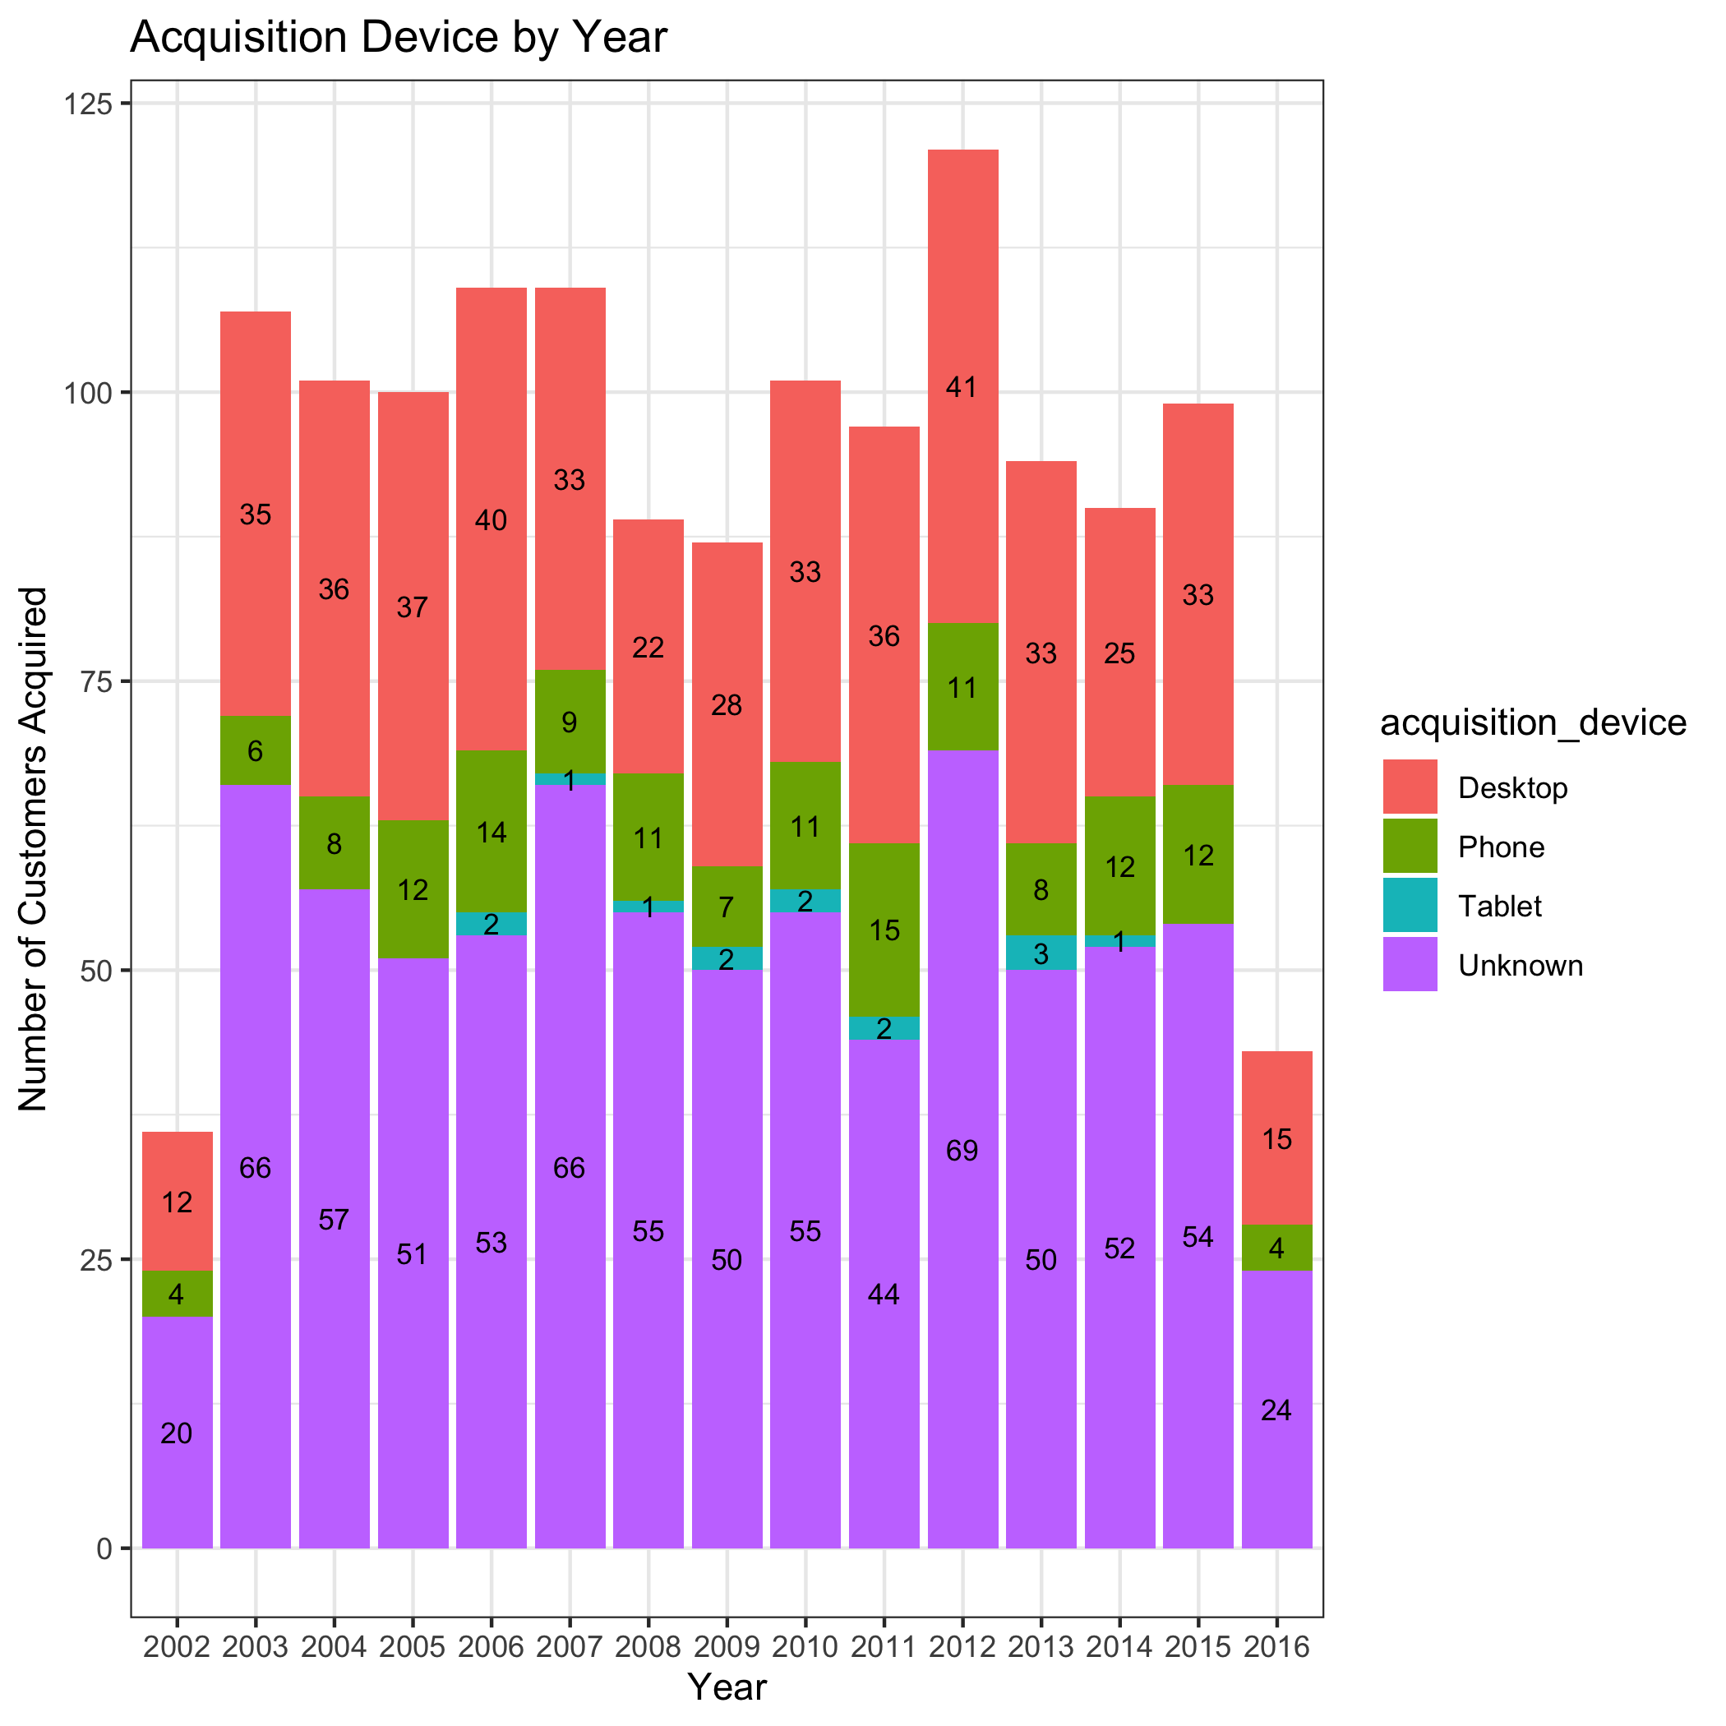
THE NUMBER OF customer acquired by ACQUISITION DEVICE ARE stable BY YEARS

Slide 11
SUMMARY AND RECOMMENDATIONS
Paid Search and Organic Search are consistently the channels with the most customers acquired. Comparison Shopping has experienced an increase in number of customers acquired in recent years. The percentage of new customers from Paid Search has experienced a decline.
Most customers (with a known acquisition device) are acquired through Desktops.
RECOMMENDATIONS:
Clean up and fix issues in data collection to reduce the number of Unknown entries in acquisition device and channel. This will be important to understand where our new customers come from and develop customer acquisition strategies.
If Paid Search budget hasn’t changed:
Invest in Comparison Shopping through Ads, and customer behavior seems to trend in this direction
Change content or placement design with Paid Search to make sure the number of customers acquired from this channel improves.

Slide 12
2. SKU CLASS ANALYSIS

Slide 13
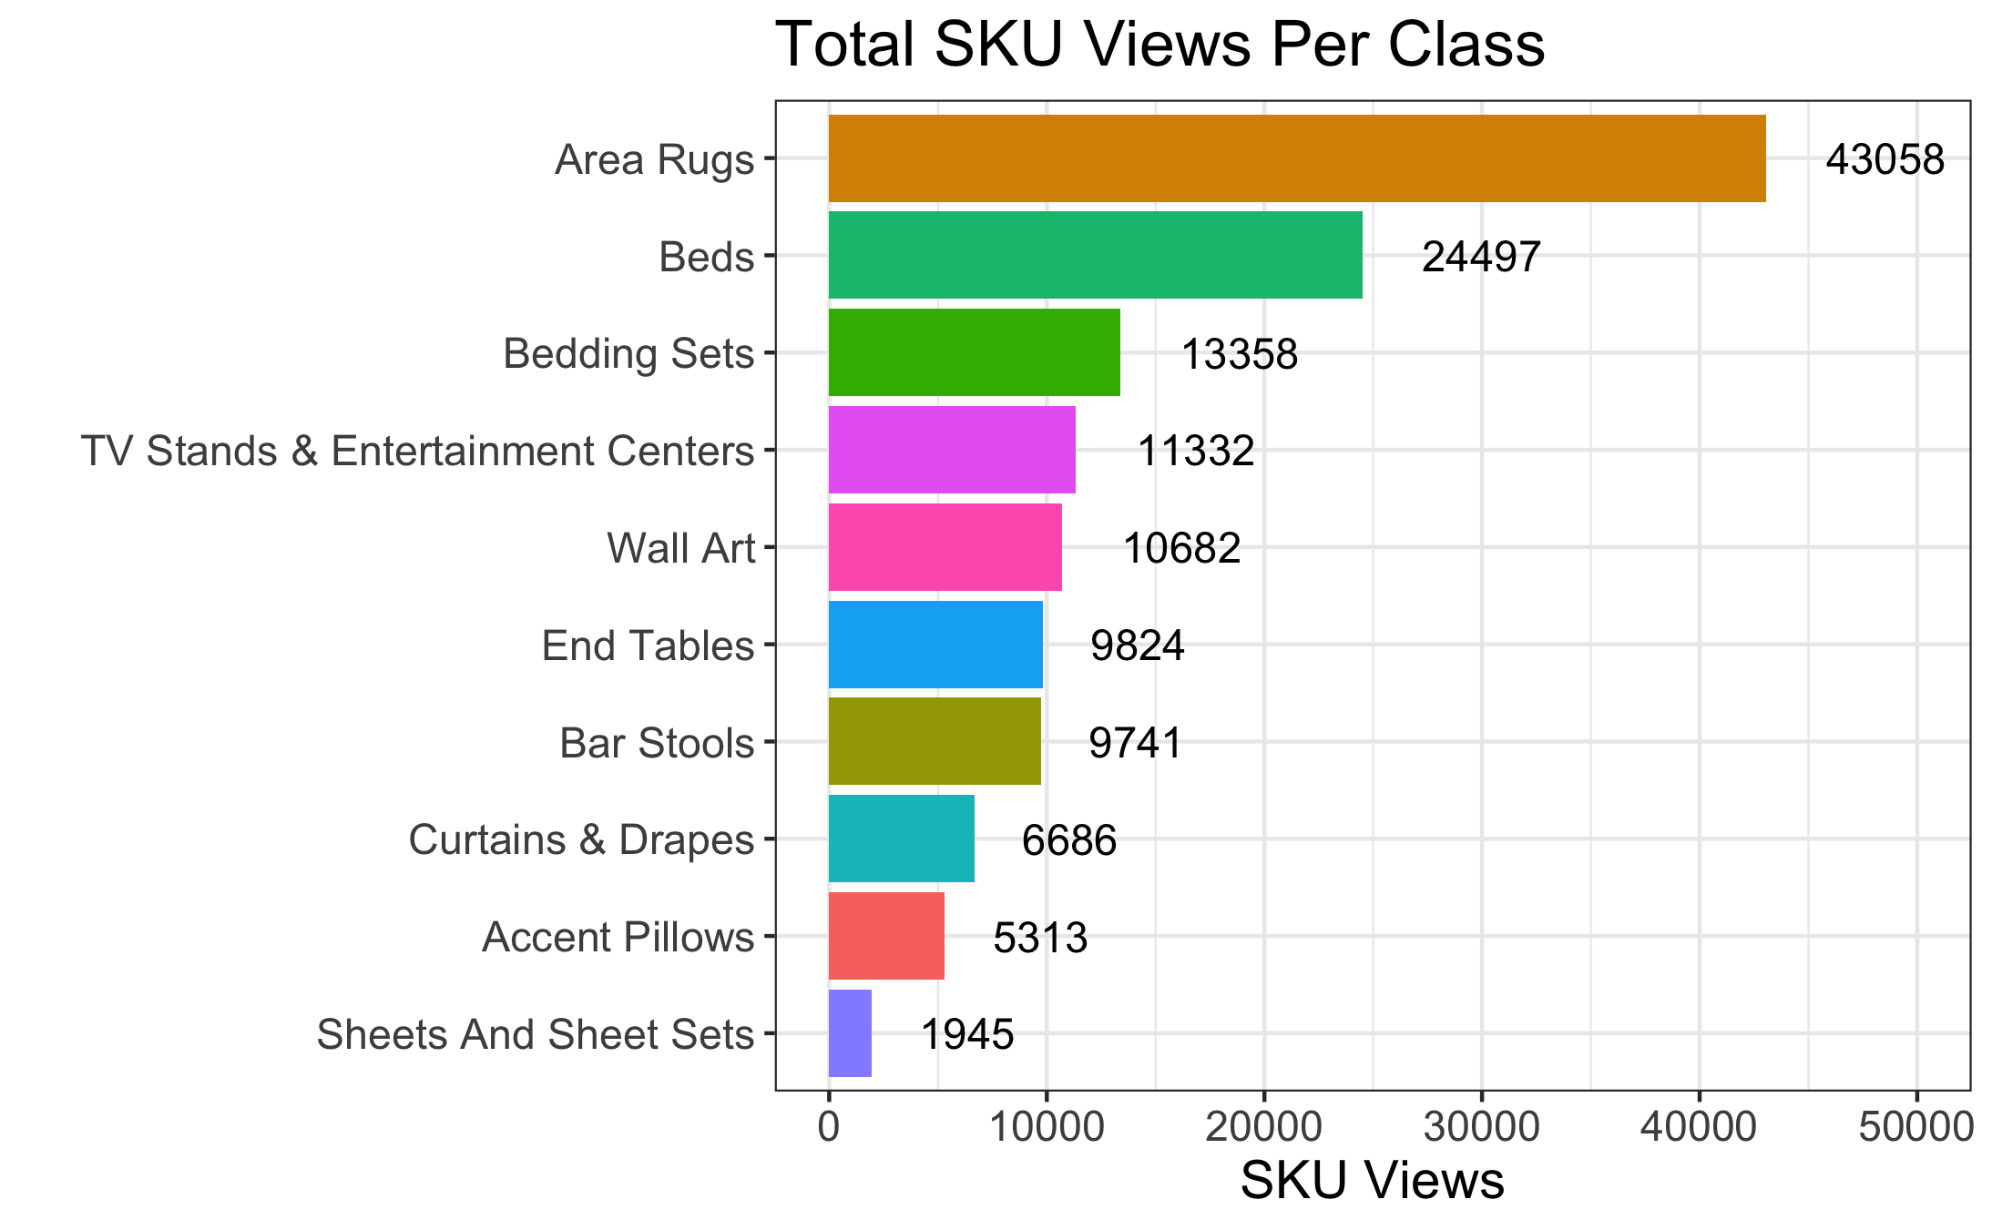
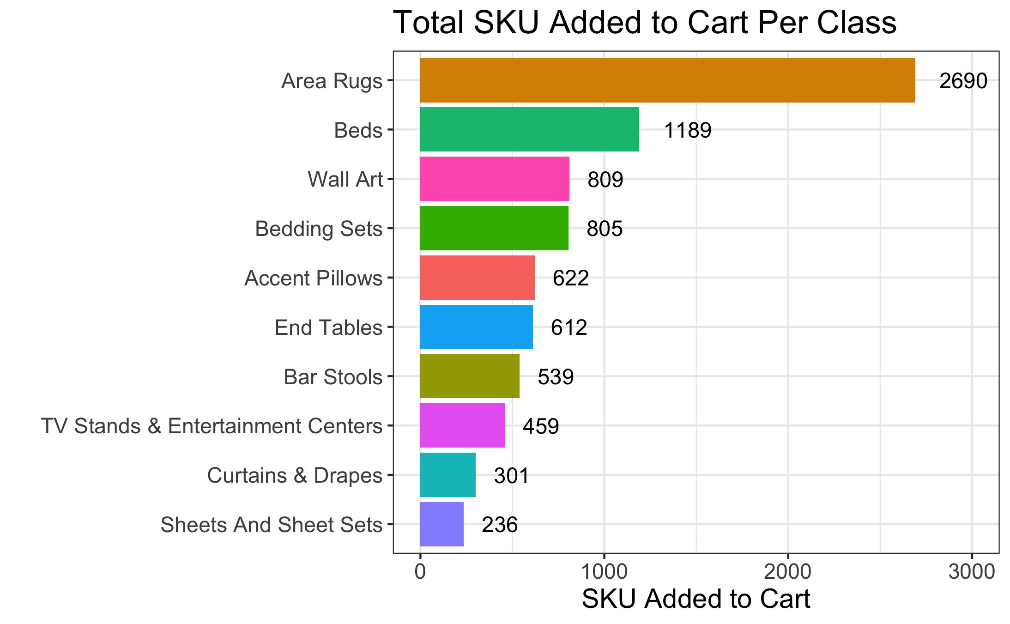
area rugs and beds have SKU View and added to cart items count
Areas Rugs, Beds, Bedding Sets and Wall Arts have very high total SKUs viewed and total SKUs added to cart. TV Stands and Entertainment Centers has high number of views (#4), but low number of items added to carts (#8), which suggests potential design or pricing issues, or customer being more selective as these are higher-priced SKUs. Contrarily, Accent Pillows has low views (#9), but higher number of items added to carts (#5), suggesting the design or quality of these items satisfied customers who need or search for them. Better marketing can potentially increase the views and purchases of these items. Sheets and Sheet Sets is the lowest performing class in terms of views (#10) and added to cart (#10), which suggest either quality or marketing issue, or both. This is also concerning because its complimentary classes (Beds and Bedding Sets) perform relatively well.

Slide 14
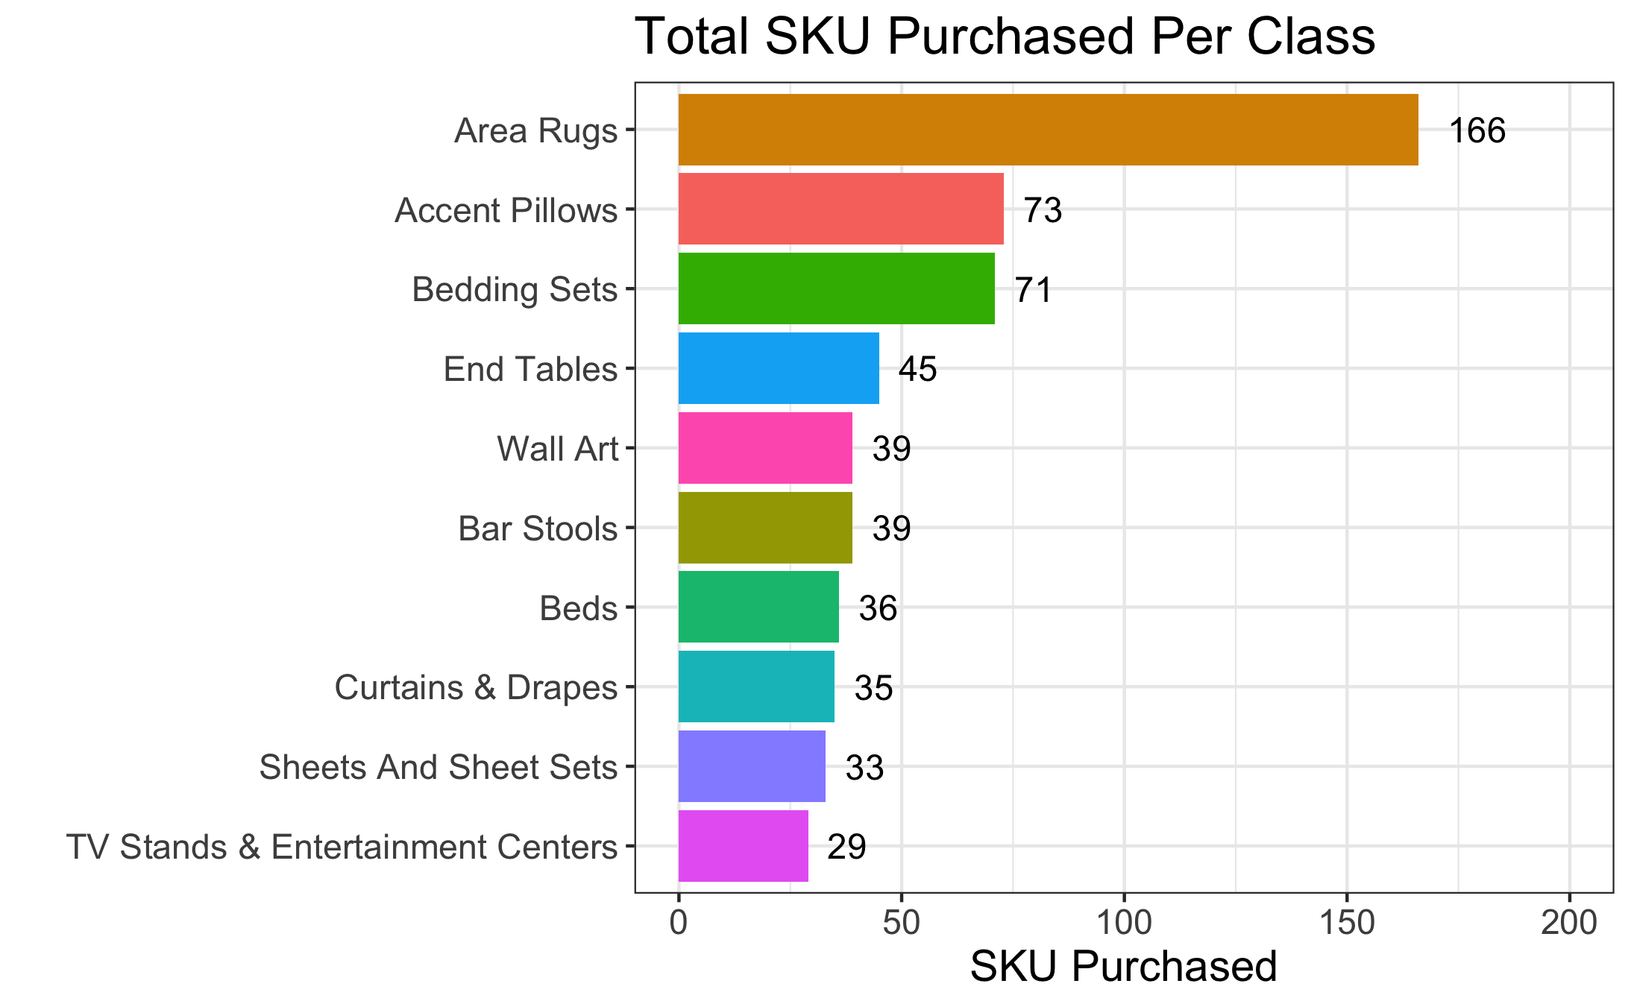
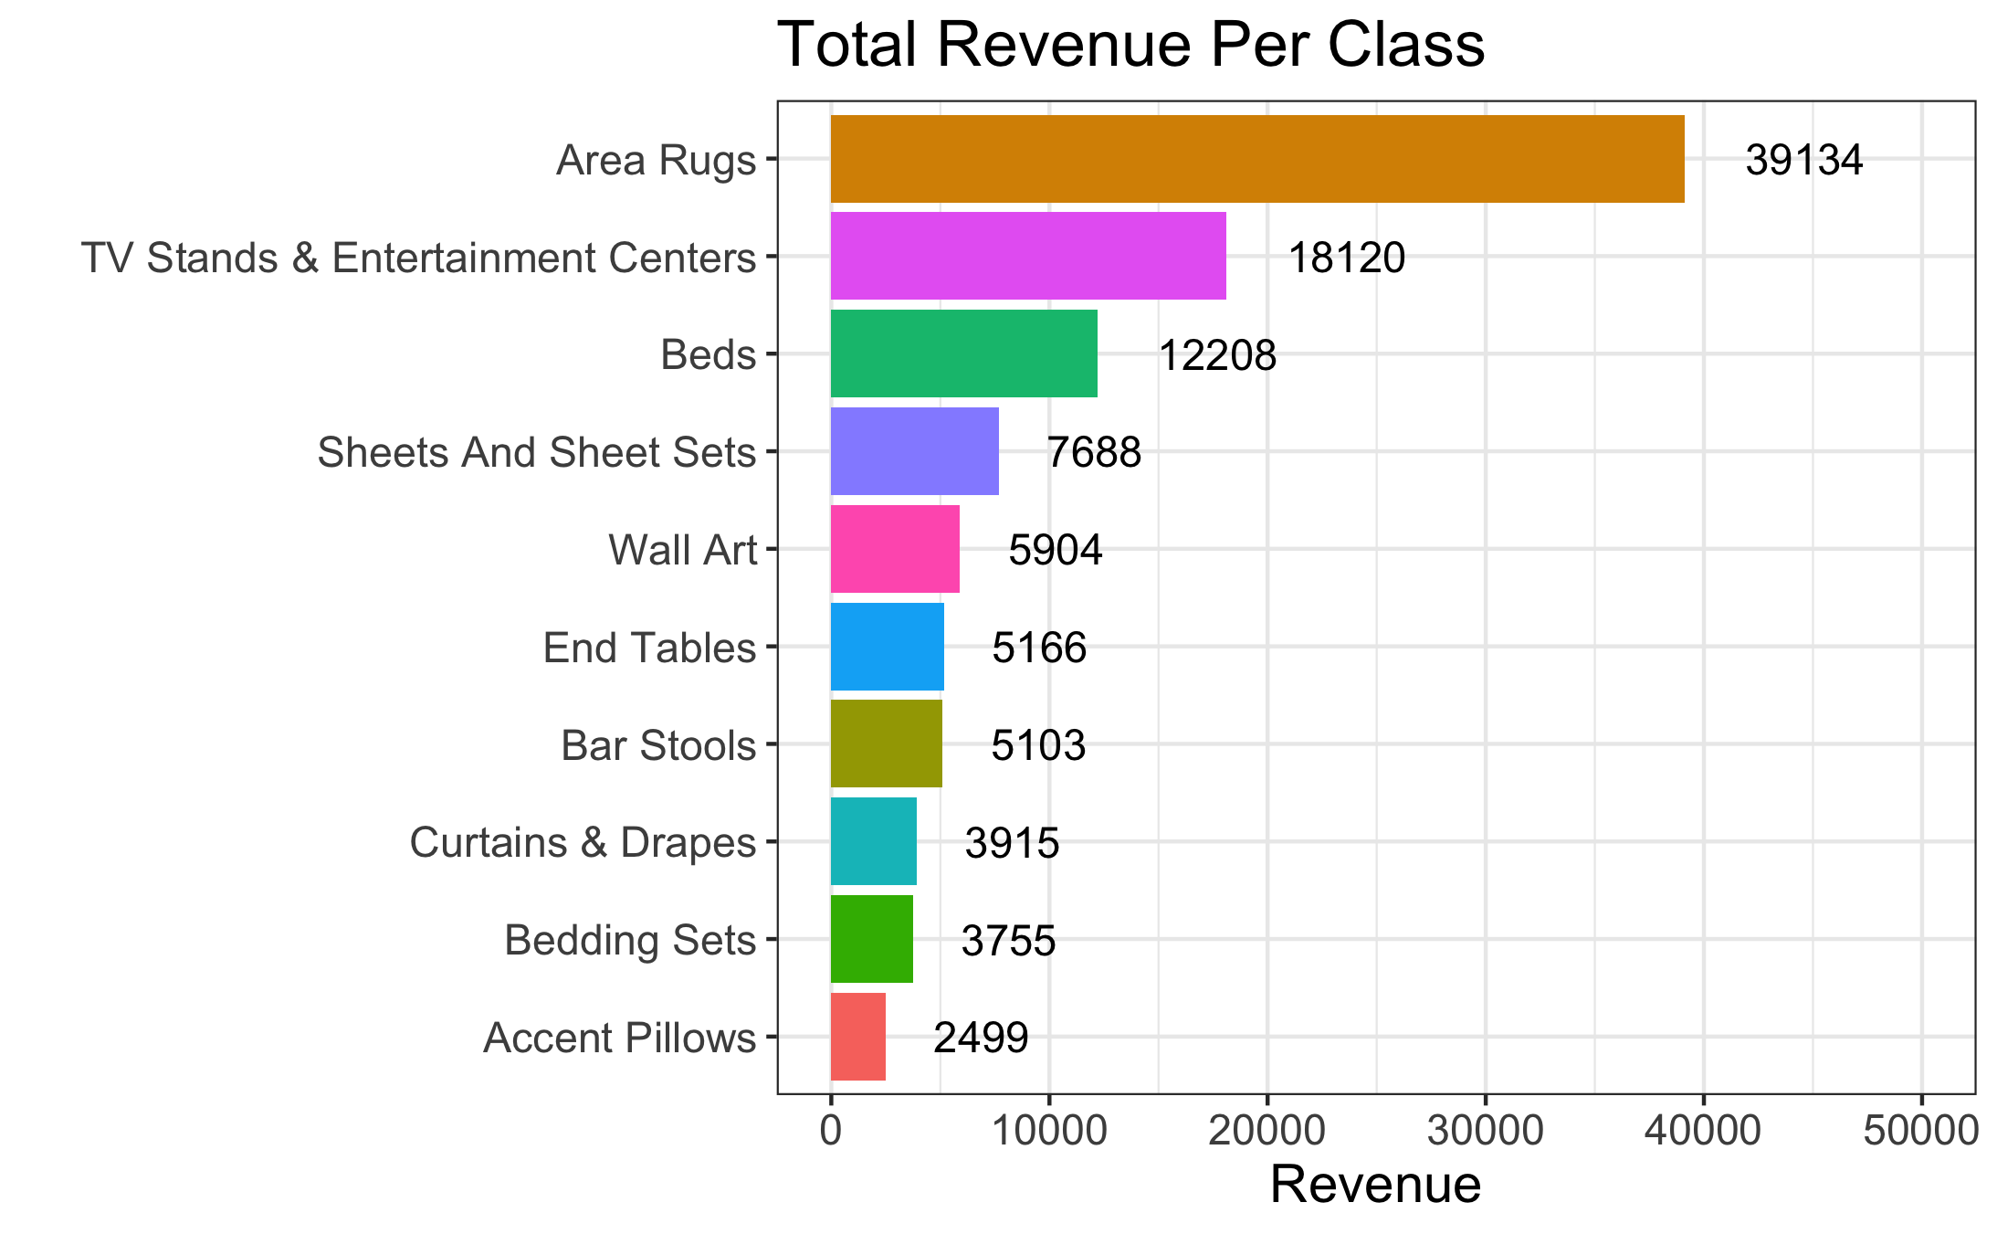
area rugs has highest # purchases and revenue. Accent pillows follow in terms of # of purchases. Tv stands & beds are categories with high revenues.
Areas Rugs is by far the top performing SKU class in terms of number of purchases and revenues. Accent Pillows has very high number of purchases (#2) but low revenues (#10), suggesting that each item has a low price. This is also true with Bedding Sets. Cross-selling between these items and complimentary items can potentially increase revenue. Contrarily, Beds and TV Stands & Entertainment Centers has low number of purchases (#10) but high total revenue (#2), suggesting that these are higher-priced items. Overall, Curtain & Drapes has low number of purchases (#8) and quite low revenue (#8), which can be a cause for concern.

Slide 15
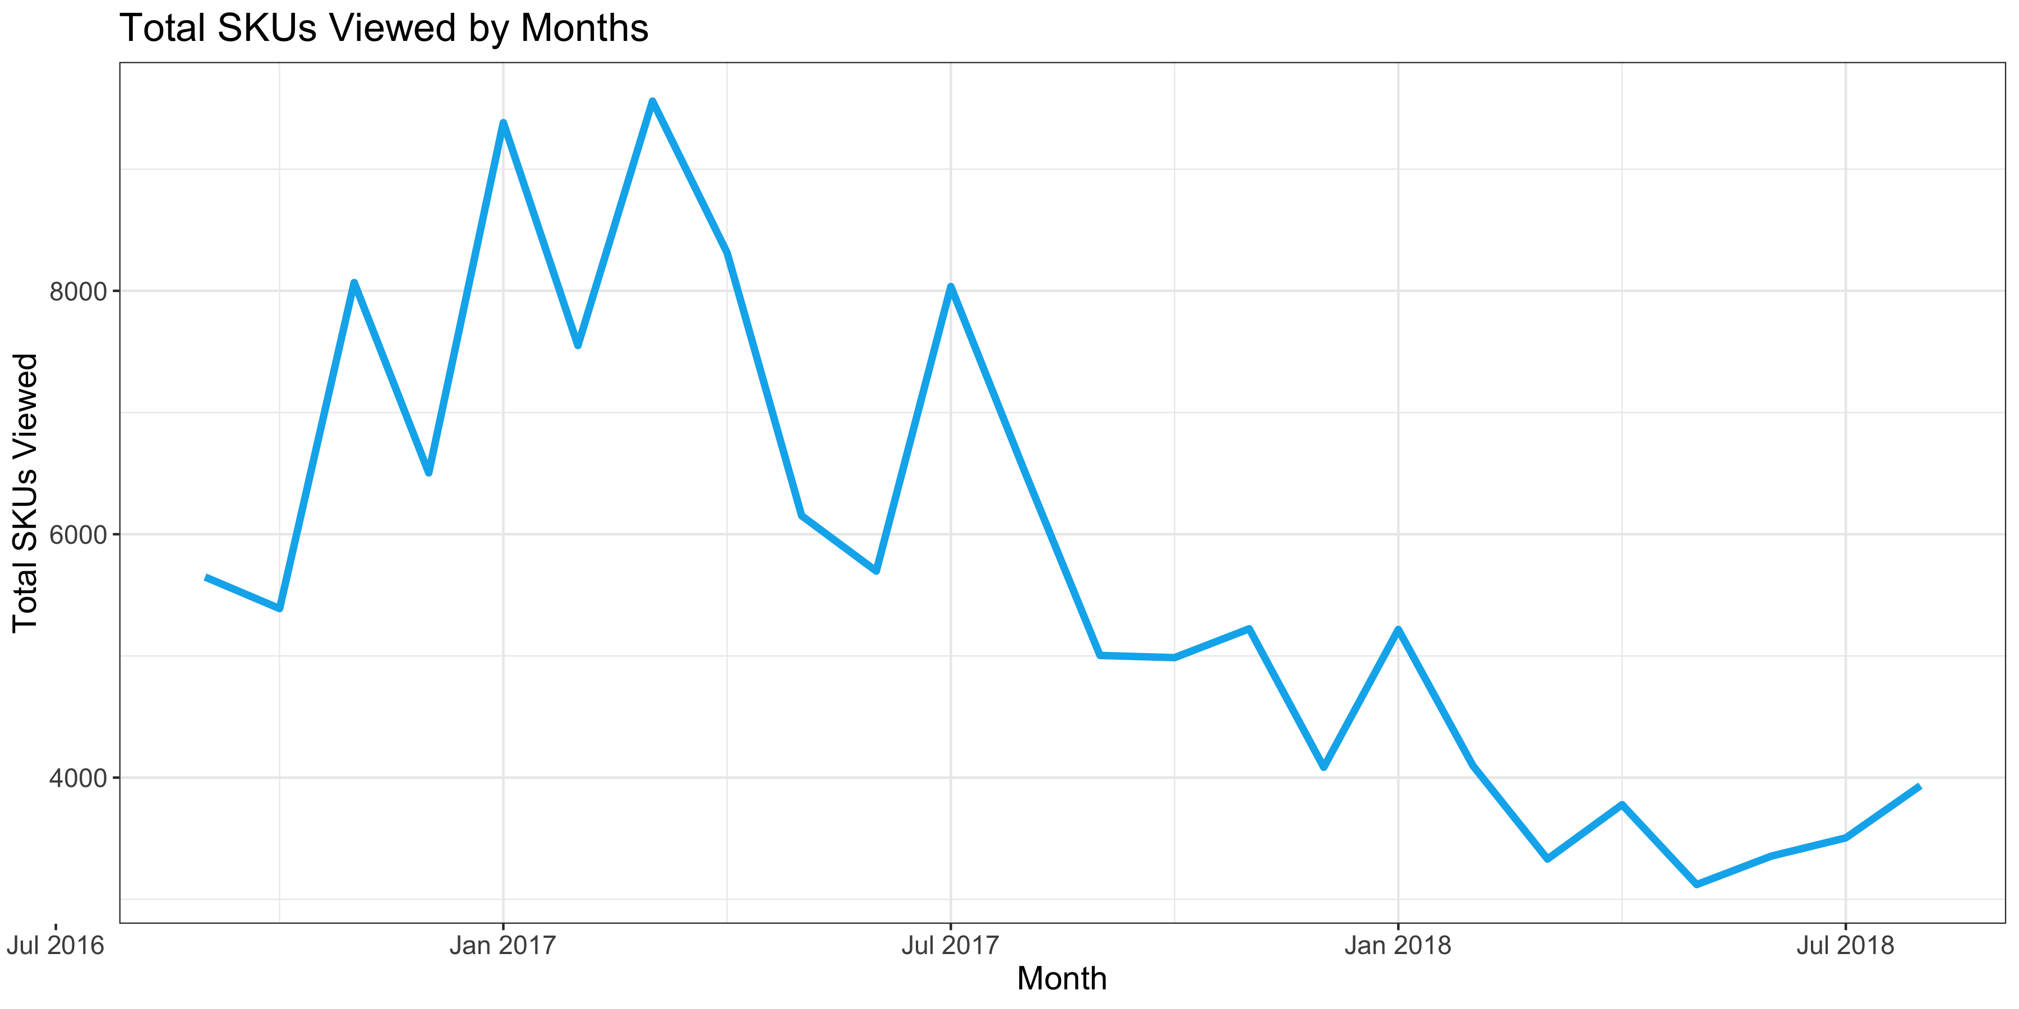
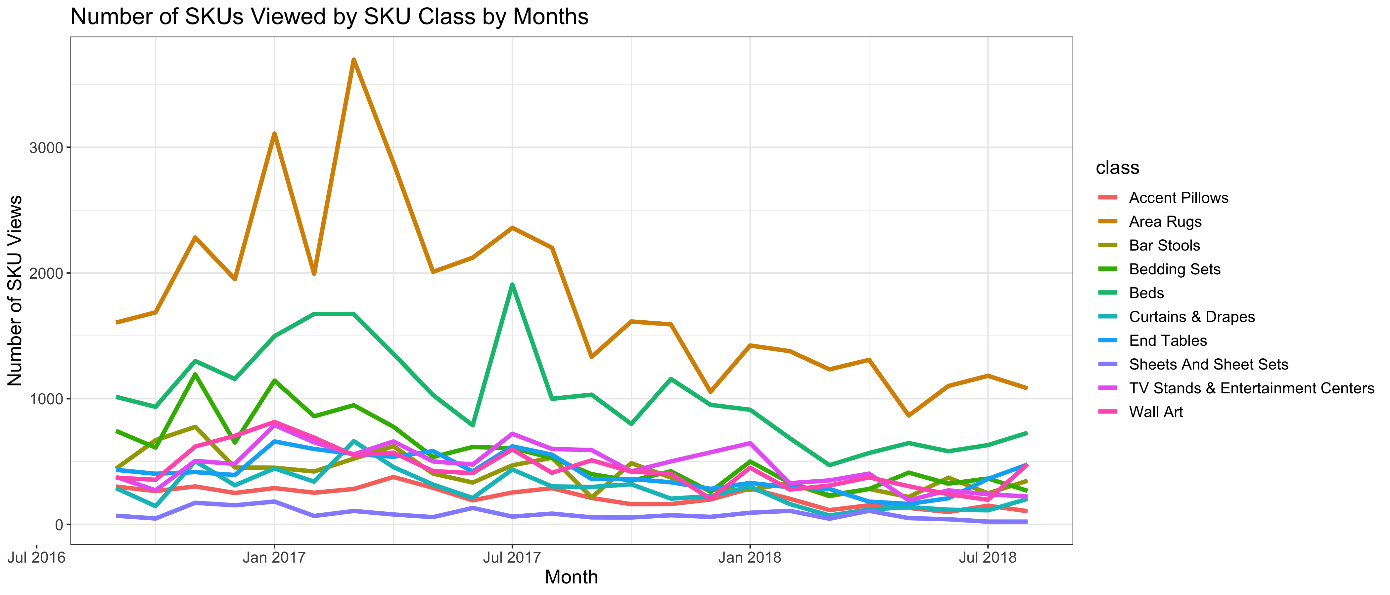
Total views of all SKU classes have downward trends from September 2016 to August 2018
Total number of SKUs viewed drops 58.85% from Mar-17 (peak) to Aug-18.
Area Rugs class has highest total views across all months, followed by Beds. They also experience the highest drops from early 2017 to August 2018.
Sheets And Sheet Sets consistently has the lowest number of total views across all months.

Slide 16
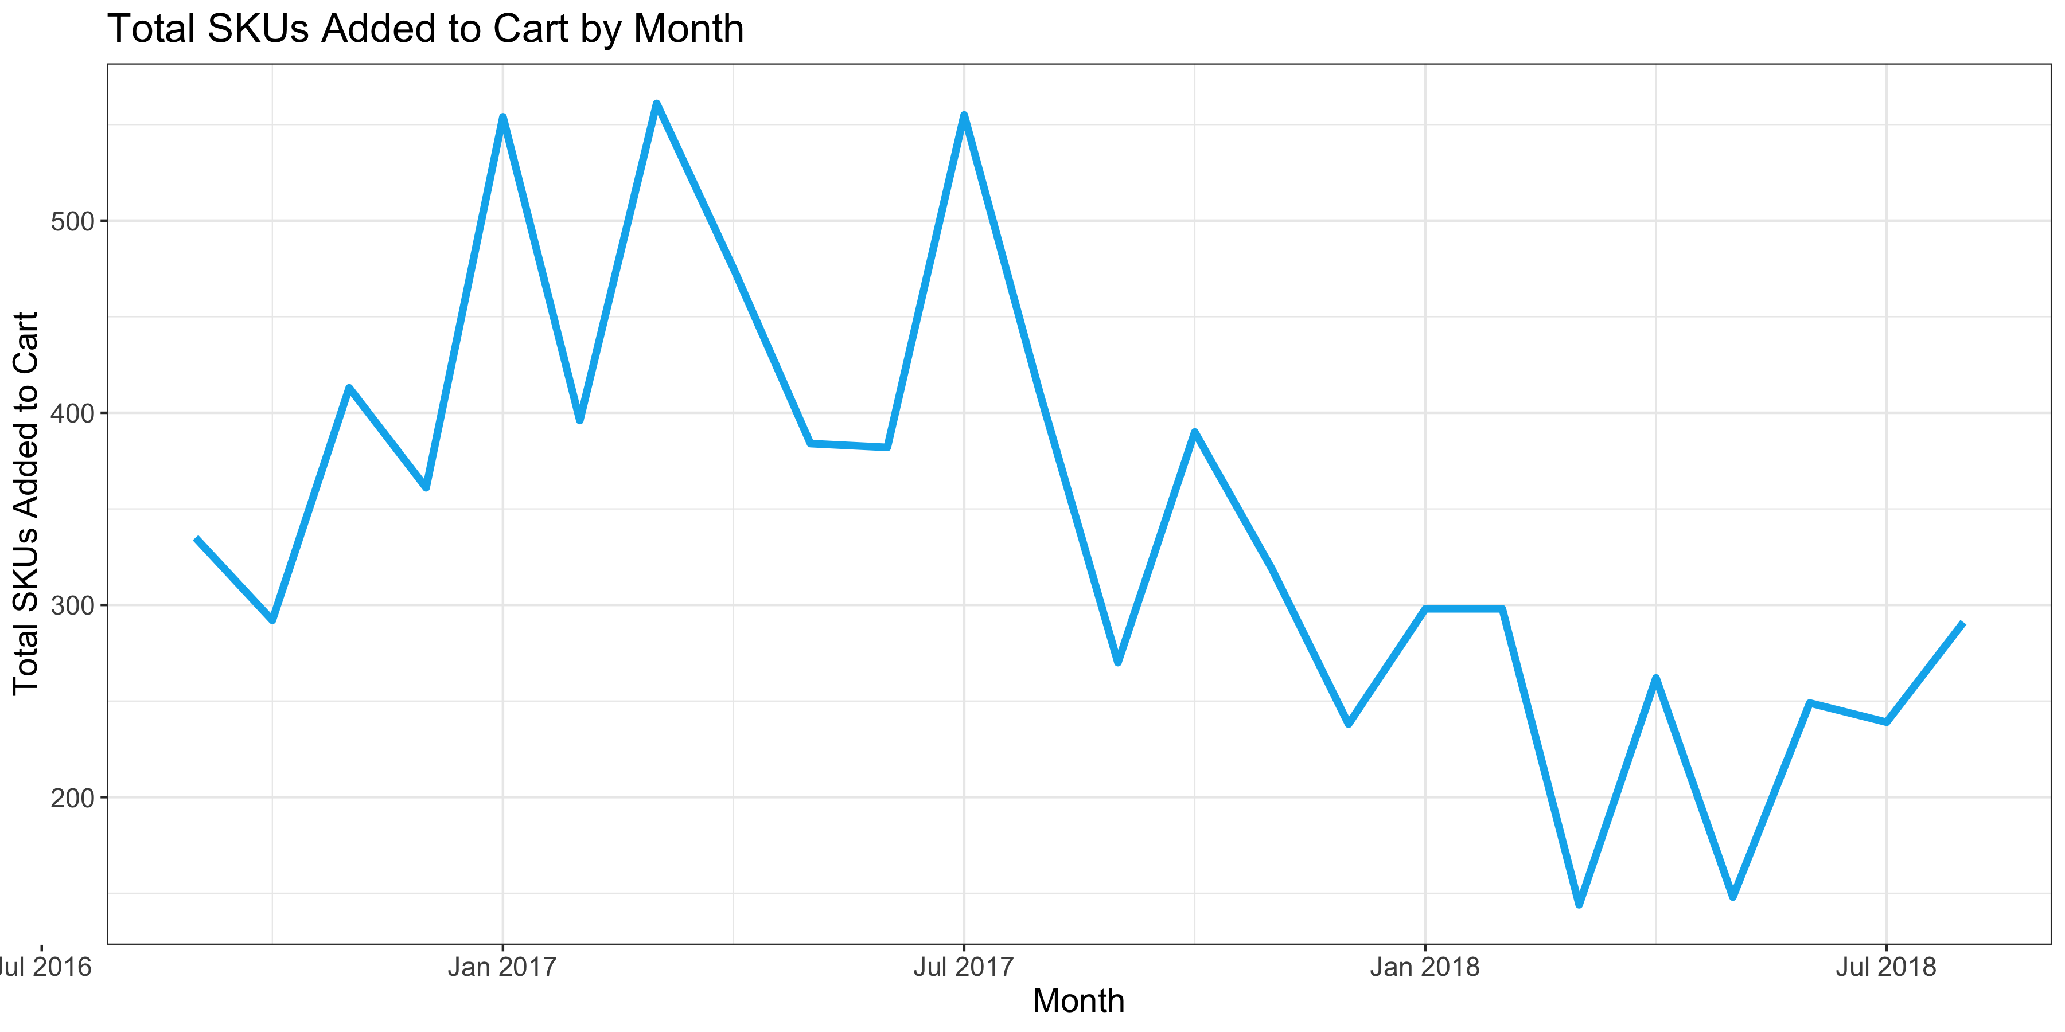
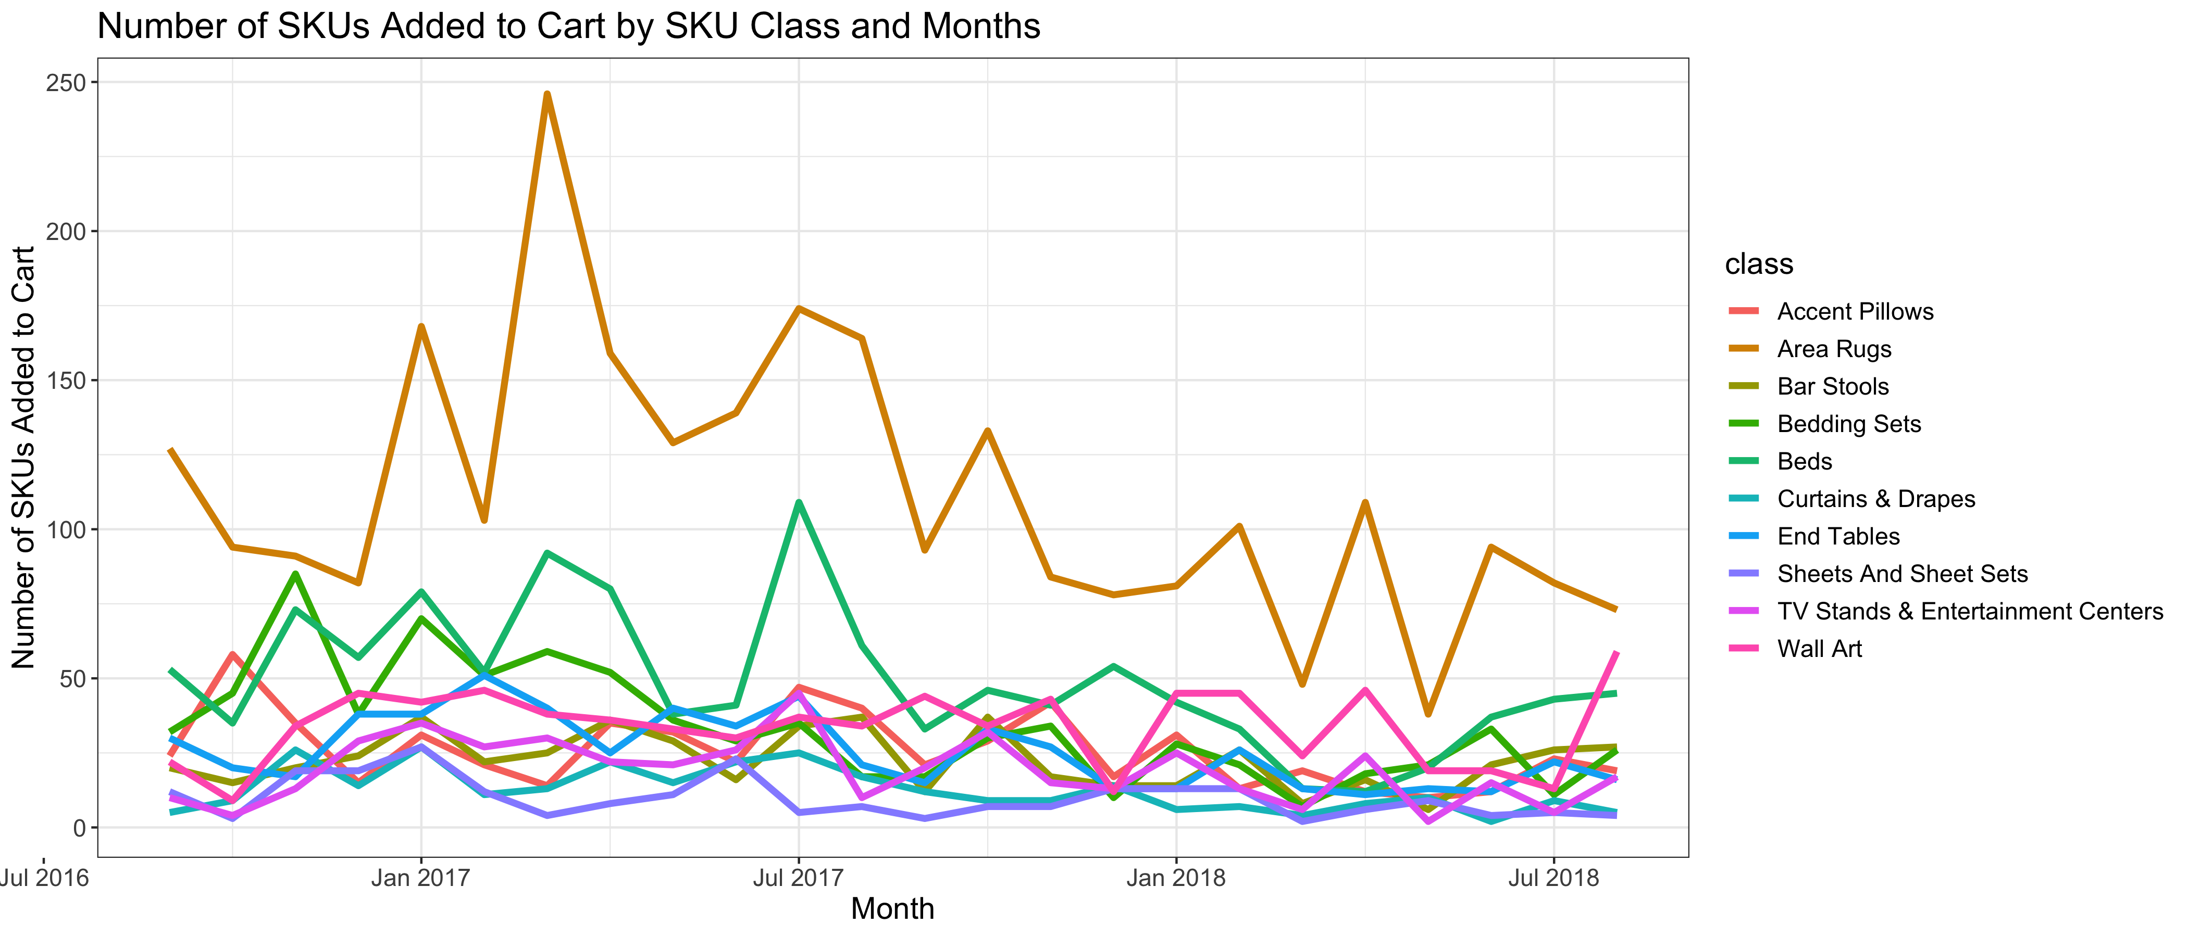
Similarly, total items added to cart dropped from September 2016 to August 2018 for most classes, except for Wall Art, TV Stands
Total number of SKUs added to cart drops 48.13% from Mar-17 (peak) to Aug-18.
Area Rugs class has the highest total views by month, followed by Beds. In the last few months, Wall Art has taken over Beds to be the second most items added to cart.
Sheets And Sheet Sets, End Tables and Area Rugs have the highest drop in term of percentages.

Slide 17
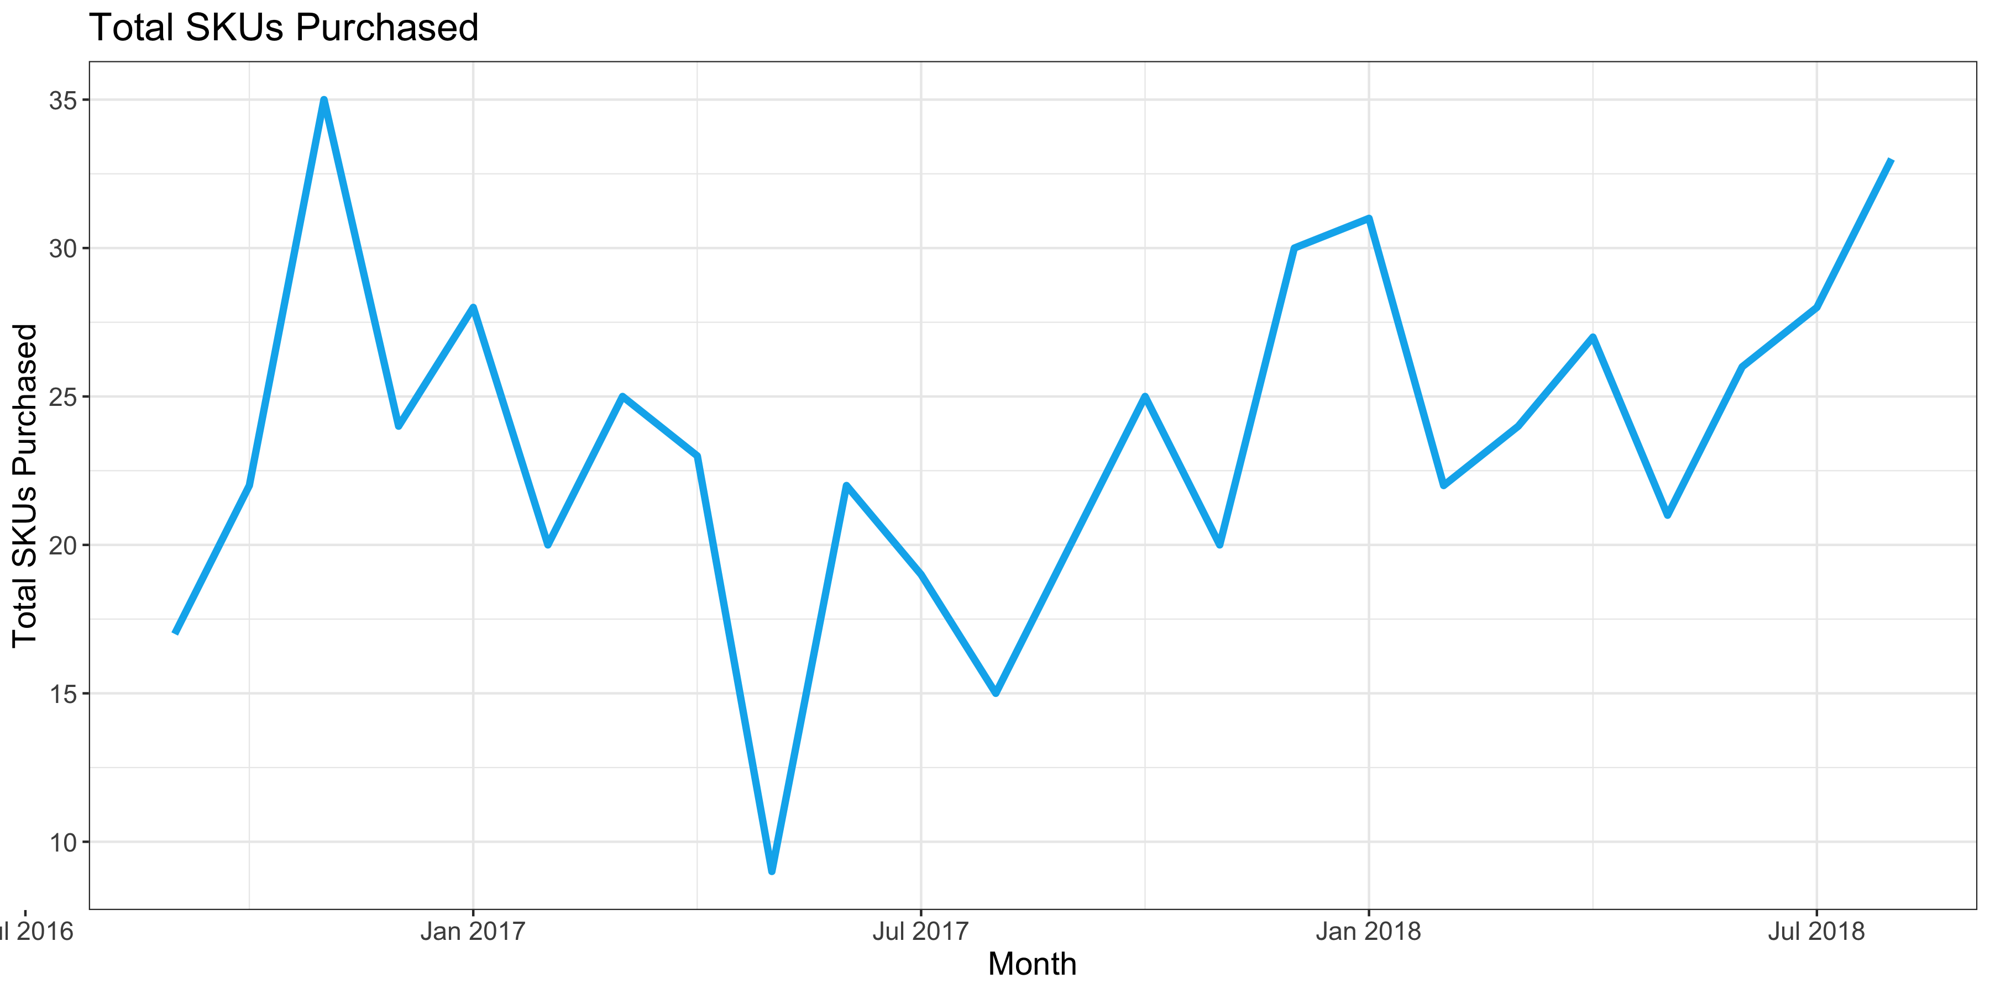
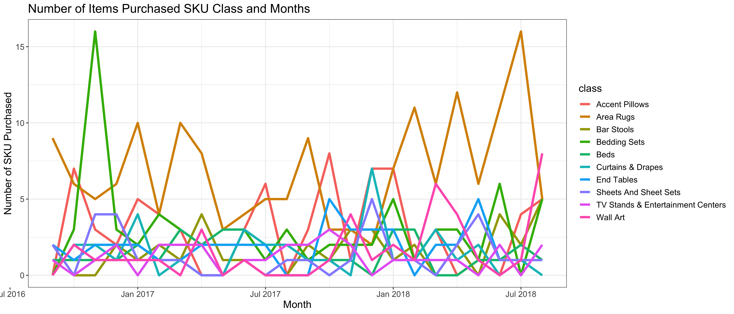
Number of SKUs purchased dropped significantly in May 2017 but has recovered since
Number of SKUs purchased dropped significantly from Nov-16 to May-17 but has since recovered and trended upward.
While there is no clear monthly pattern, Area Rugs is almost always the SKU class with highest number of SKUs purchased. The number of SKUs purchased for this class dropped to a low in late 2017 but has since recovered.

Slide 18
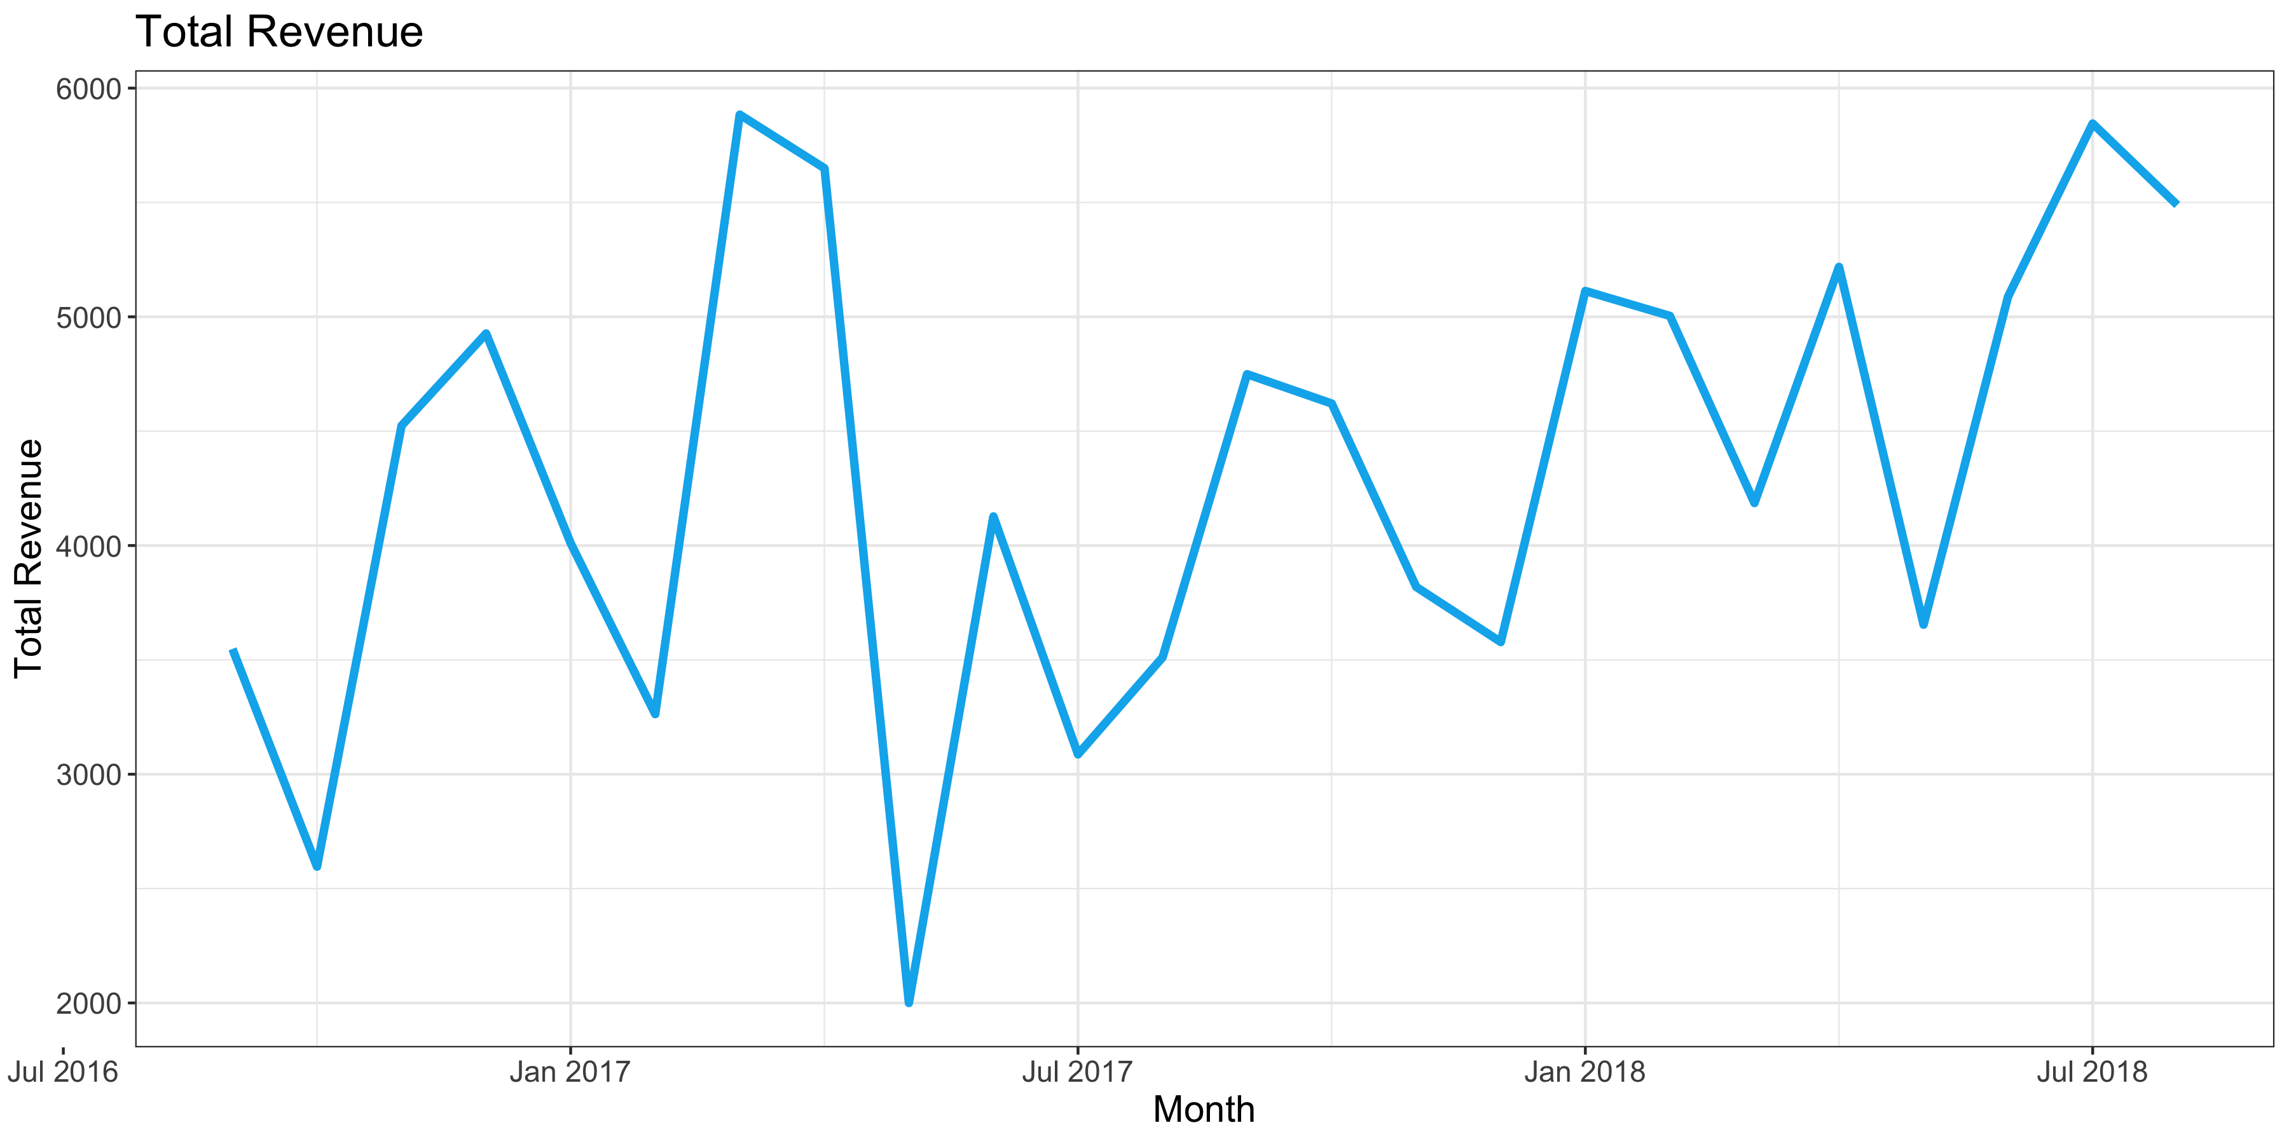
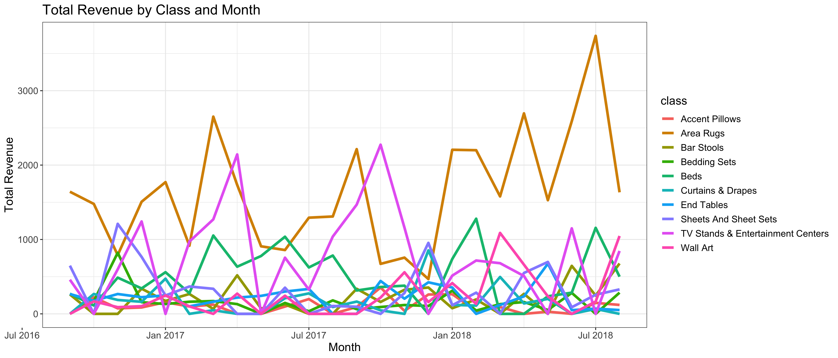
Revenues are trending upward, largely thanks to area rugs, beds and tv stands
Similar to # of SKUs purchased, revenue dropped significantly from Nov-16 to May-17 but has since recovered and trended upward.
While there are a lot of noises in monthly pattern, this upward trend seems to be driven by Area Rugs, Beds and TV Stands & Entertainment Center.

Slide 19
SUMMARY AND RECOMMENDATIONS
The Area Rugs class has highest metrics: SKU views, items added to cart, purchases and revenues generated. While number of purchases and revenue has recovered in recent years, downward views and items added to cart can be a signal of trouble in terms of marketing. As this is a valuable SKU class, additional marketing or revisions in pricing strategies might be needed to address these issues.
The Beds class has very high SKU views (#2), SKU added to carts (#2) and revenue generated (#4). While it has low number of purchase, this is not an issue as a customer only typically needs one bed at a time. Like Area Rugs, declining views and items added to cart suggesting a need for better marketing, pricing strategy and customer acquisition strategy.
The Accent Pillows class has low views (#9), but higher items added to cart (#5) and very higher number of items purchases (#2). This tells us the pricing and offerings are attractive to customers who need these items. A good cross-selling strategy can bring additional revenues.
The Sheets and Sheet Sets class generated relatively high revenue (#4) but has very low views (#10), items added to cart (#10) and purchases (#9). Better marketing can add significant lift to top line.

Slide 20
SUMMARY AND RECOMMENDATIONS (CONT.)
While the total number of SKUs viewed and the number of SKUs added to cart drops, the number of SKUs purchased, and monthly revenue actually trend upward. This means that the company targets more accurate people over time. The number of people who viewed and added to cart dropped, but those who did had actually been purchasing.
RECOMMENDATIONS:
Continue to improve Area Rugs offerings and marketing plan as this is the SKU class with the highest interest and profit across time.
Cross-sell items with high purchases but low revenue such as Accent Pillows to potentially improve revenues with complimentary products. A better marketing plan for Accent Pillows is also needed, as this class has very low number of views.
Address decreasing trends in views and number of items added to cart across all classes.
Sheets and Sheet Sets has high total revenue, but low views and items added to cart. Address design/quality or marketing issues will potentially improve revenue.

Slide 21
3. Funnel analysis

Slide 22
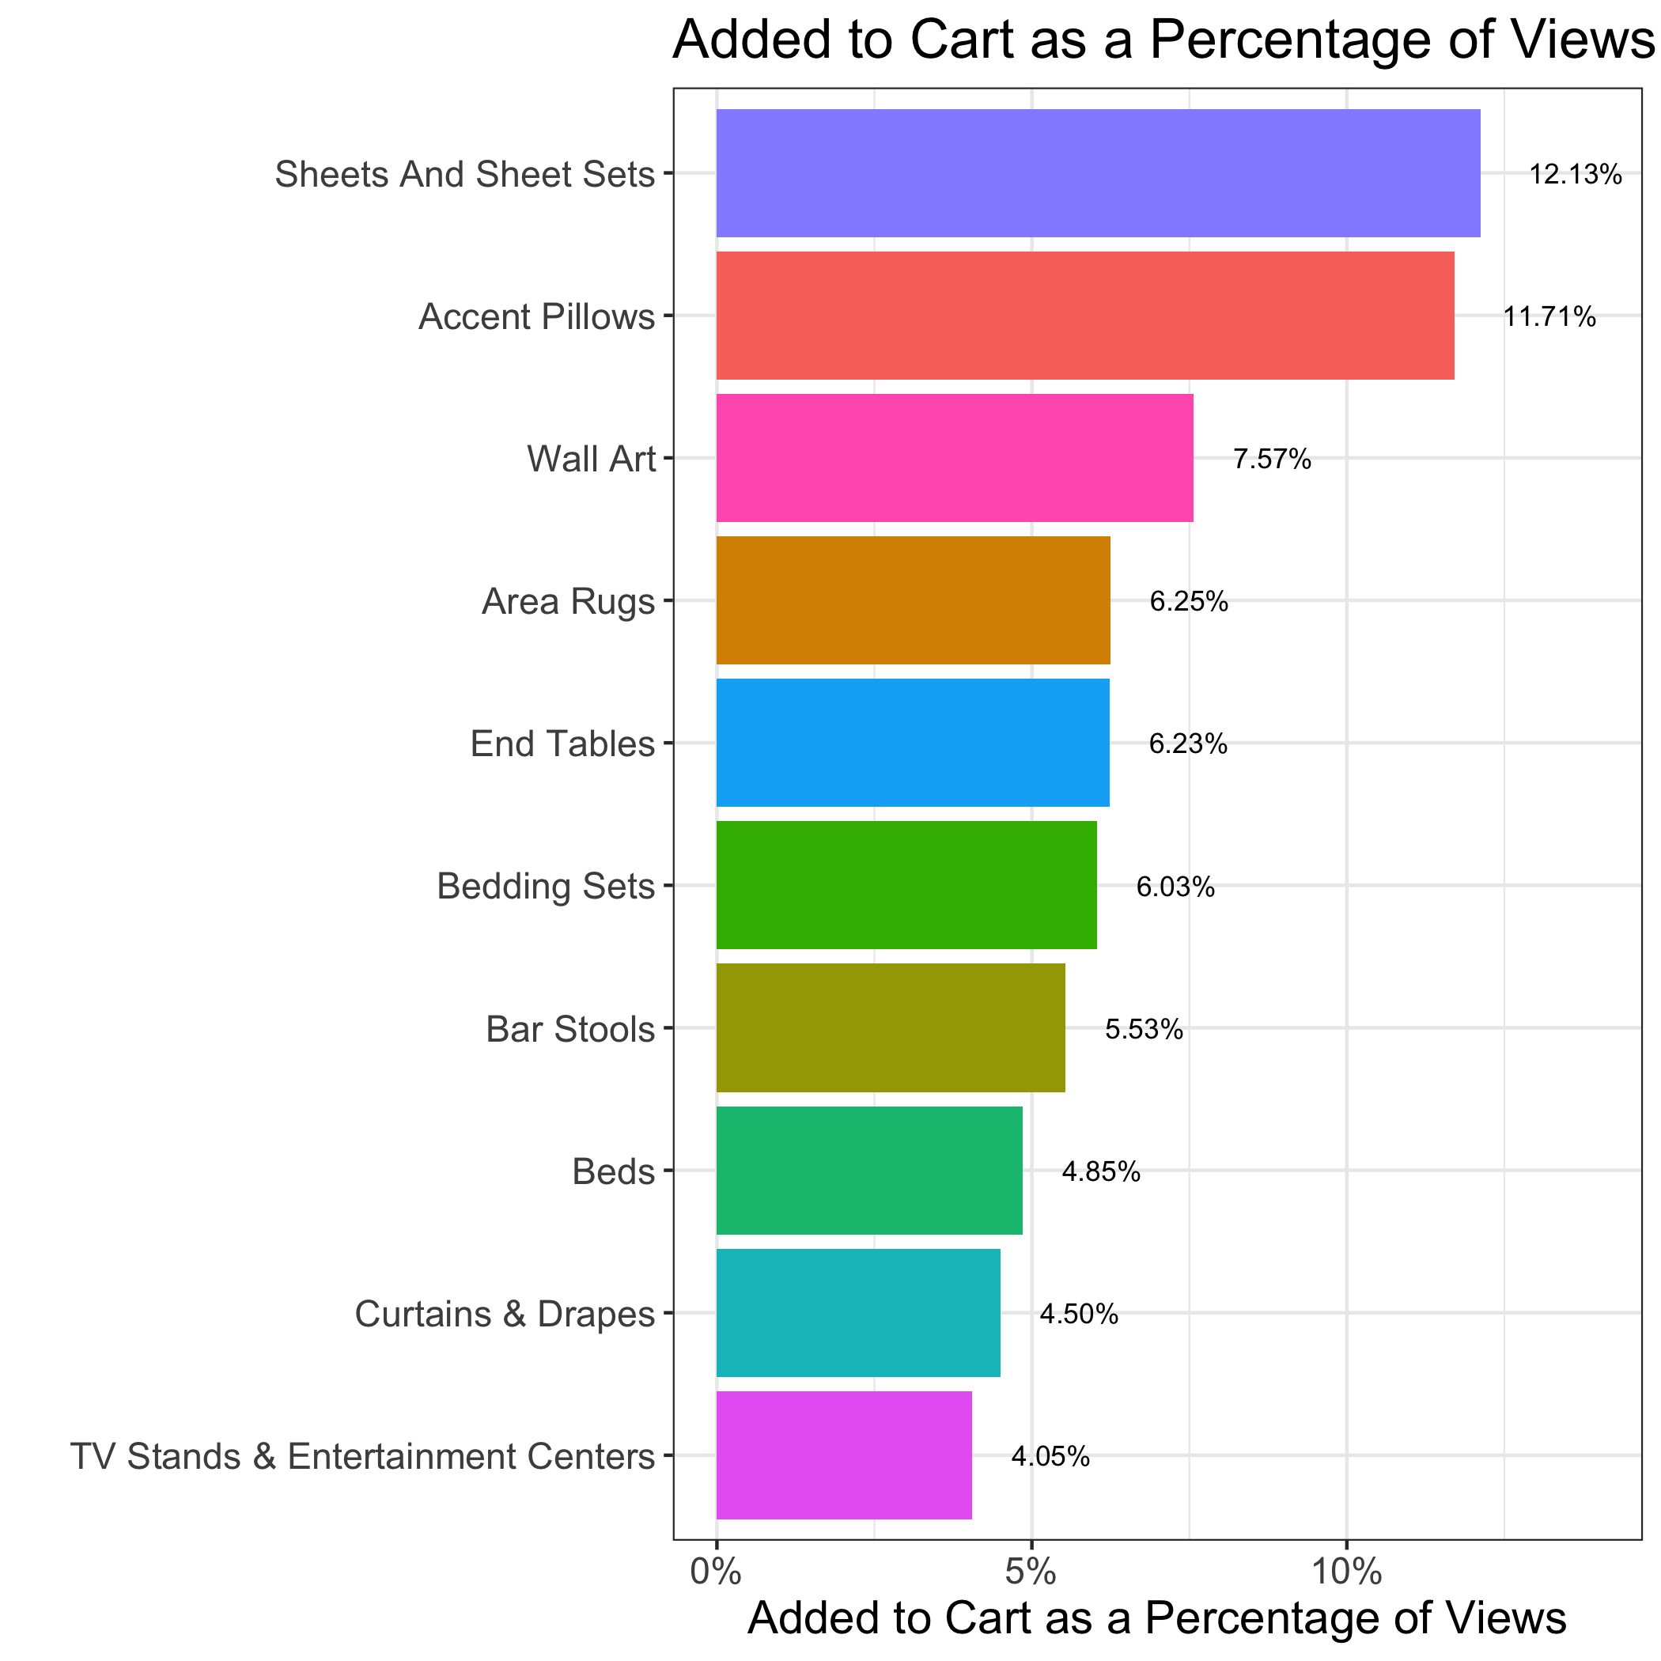
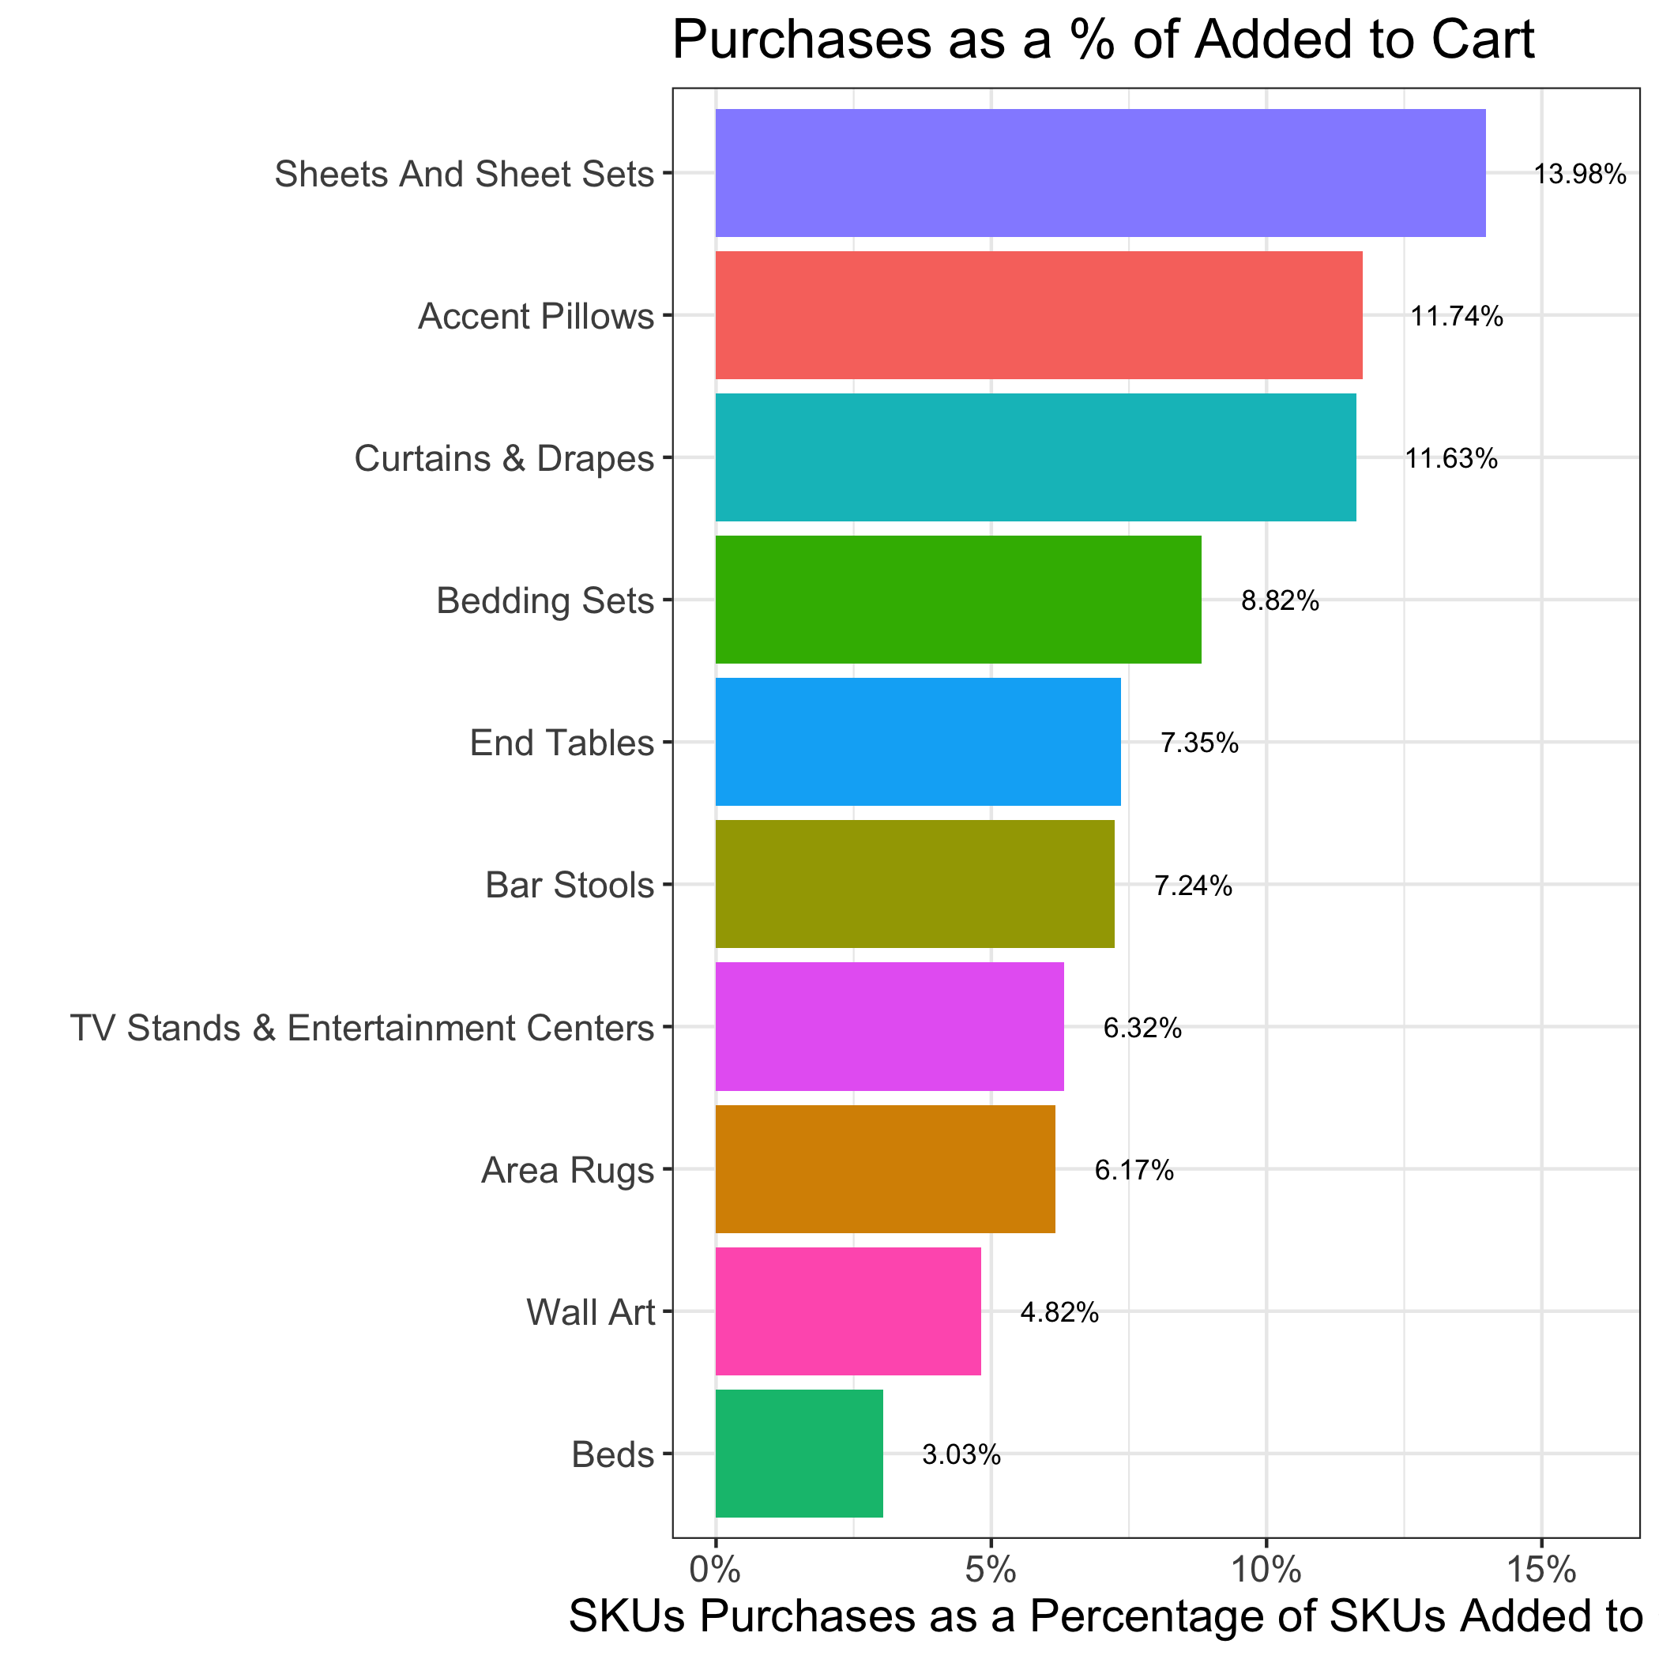
Sheets and sheet sets & accent pillows have highest view-to-cart and cart-to-purchase ratios. Area rugs & beds (classes with highest view counts), have lower ratios. Wall-art has high view-to-cart %, but low cart-to-purchase %.
SKUs Added to Cart = 6.06% SKUs Viewed
SKUs Purchased = 6.85% SKUs Added to Cart

Slide 23
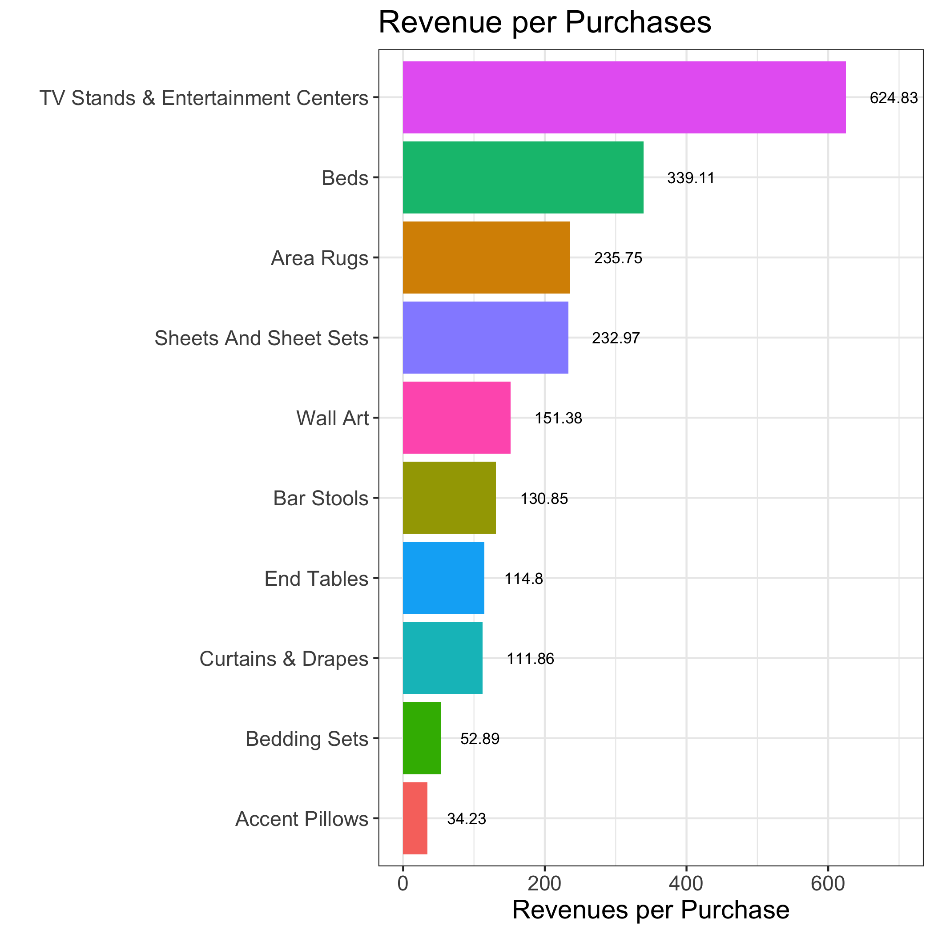
The average revenue per purchase is $182.85.
TV stands and Entertainment Center & Beds are highest-priced SKU classes.
Bedding Sets & Accent Pillows have the lowest unit prices. This potentially calls for cross-selling bedding sets and accent pillows with complimentary items to boost sales.

Slide 24
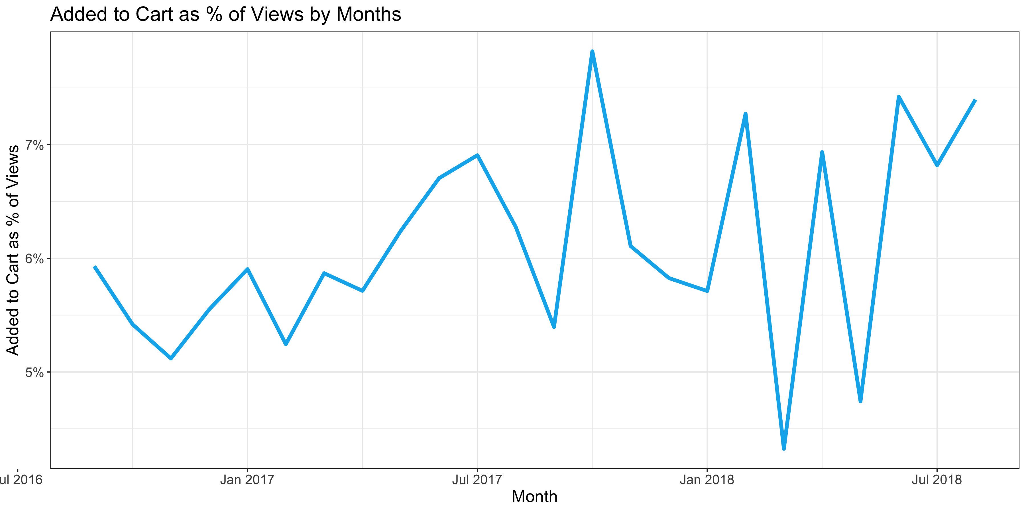
View-to-cart ratios increases 24.79% (from 5.93% to 7.4%) from sep-16 to aug-18

Slide 25
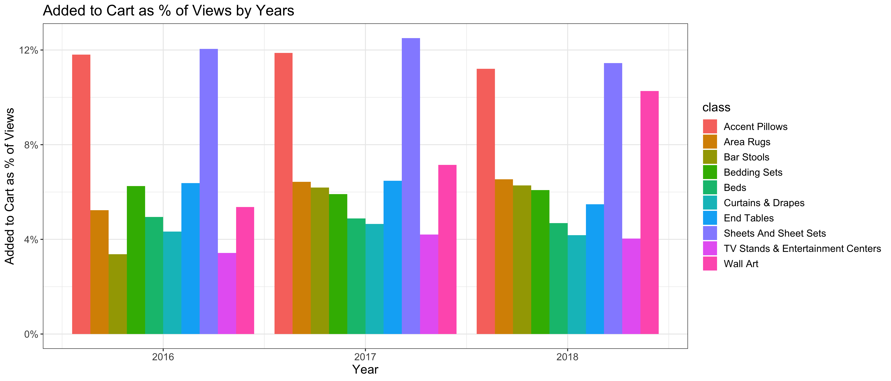
View-to-cart ratios of most classes are relatively steady over the year
Wall Art experiences a high increase in the view-to-cart conversion over the year.
Contrarily, the view-to-cart conversion rates of Accent Pillows and Sheets And Sheet Sets are trending down.
Note: This might not be the full picture for 2016 and 2018 as we only have data from September 2016 to August 2018.

Slide 26
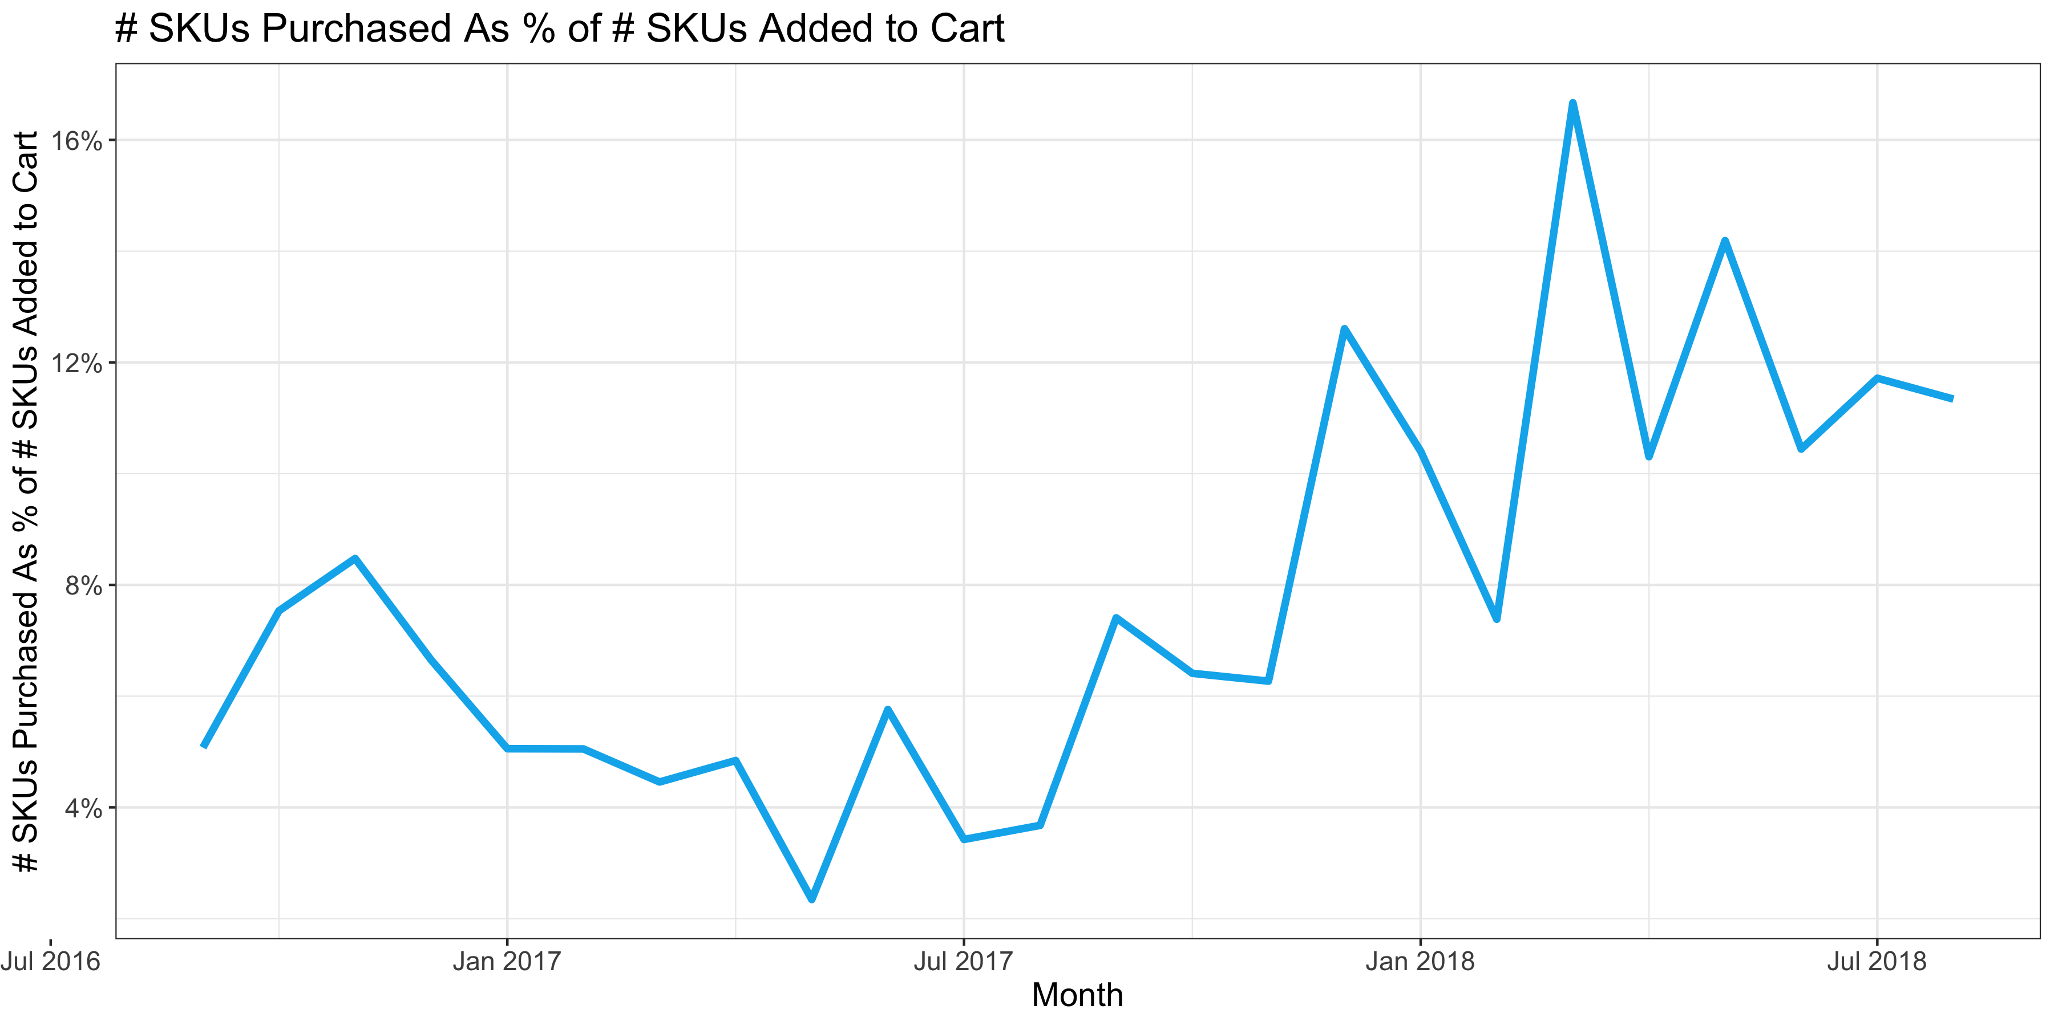
Cart-to-purchase ratios increases 122.88% (from 5.07% to 11.3%) from sep-16 to aug-18

Slide 27
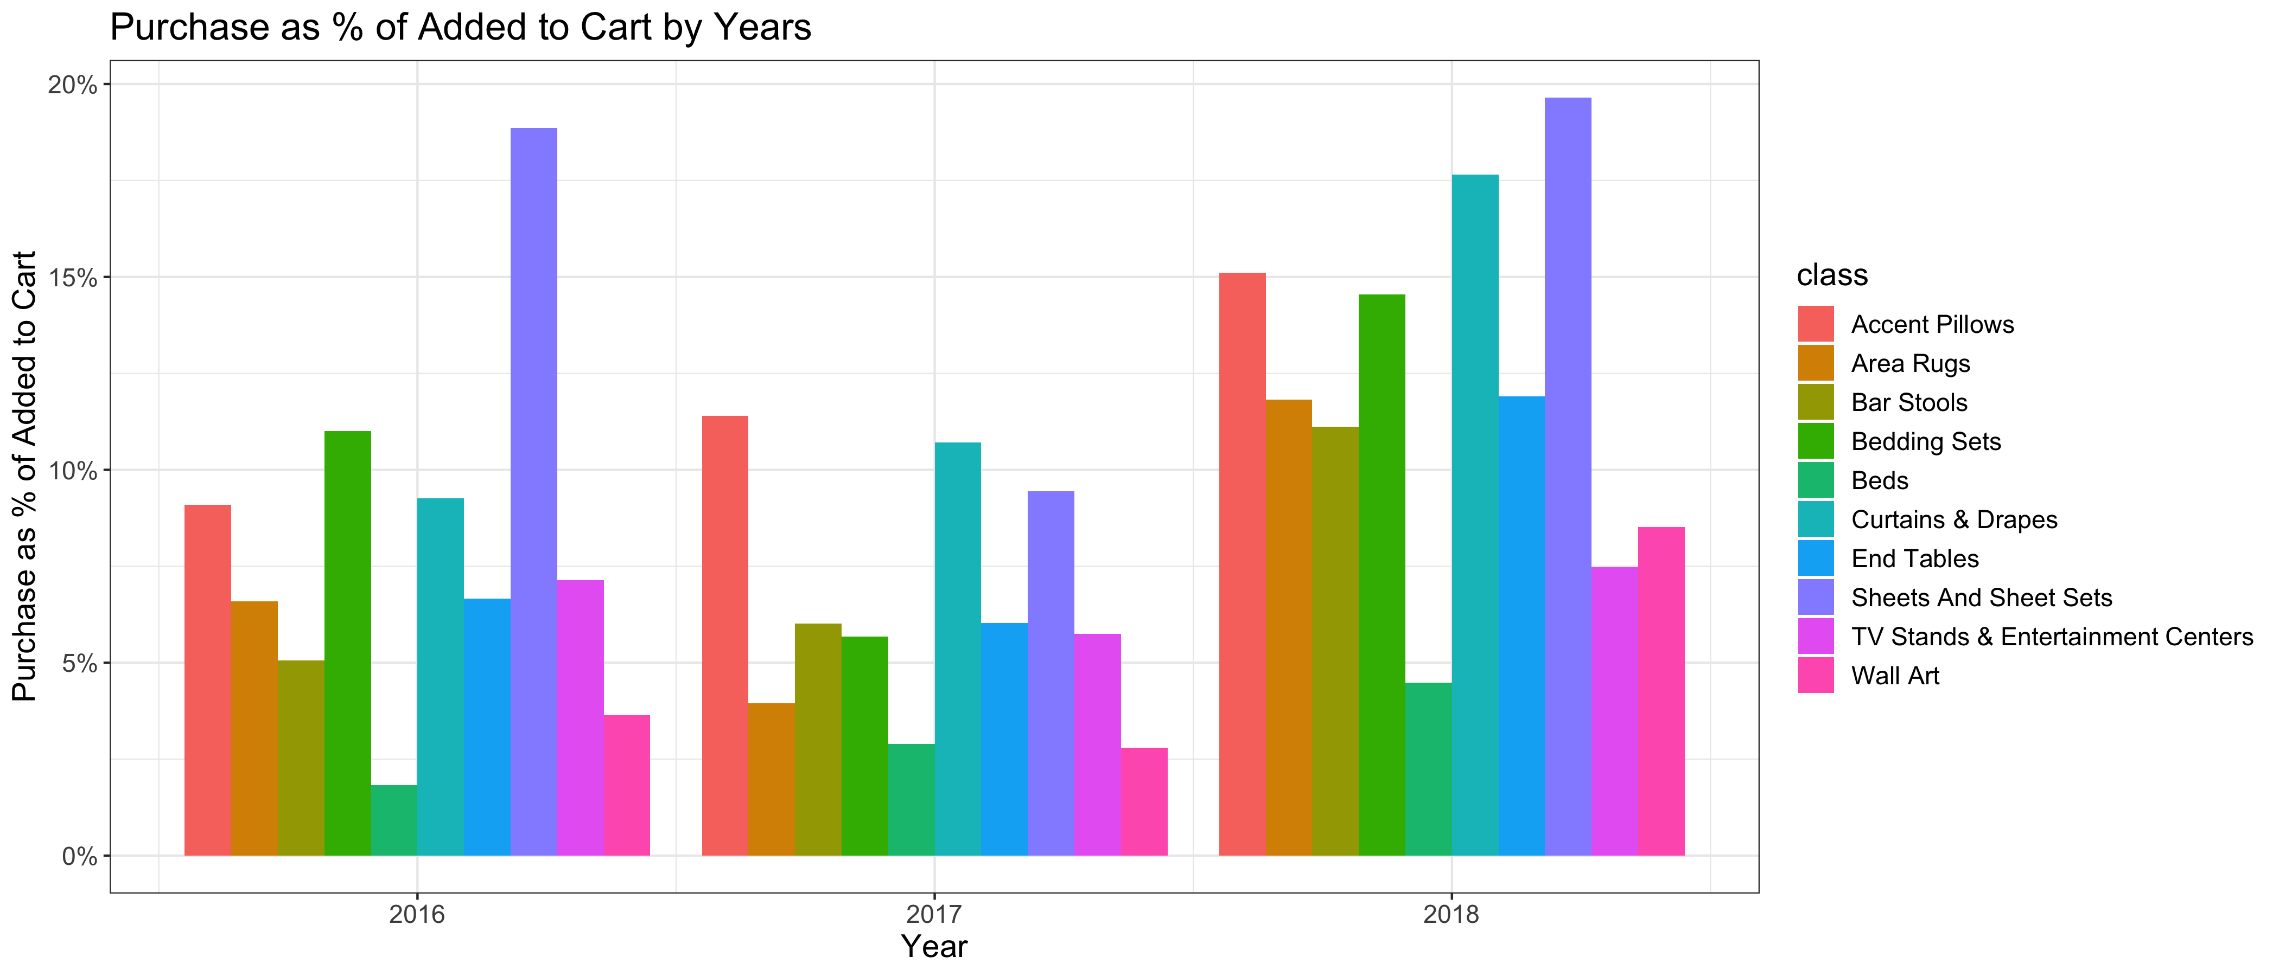
Cart-to-purchase ratio drops in 2017 and improve significantly in early 2018
There seems to be a company-wide problem in 2017 in terms of cart-to-purchase rates. But the numbers look much more positive in the first 8 months of 2018 across all classes.
Accent Pillow, Area Rugs, Bar Stools and Curtains & Drapes have seen consistent growth in cart-to-purchase conversion rate.
Note: This might not be the full picture for 2016 and 2018 as we only have data from September 2016 to August 2018.

Slide 28
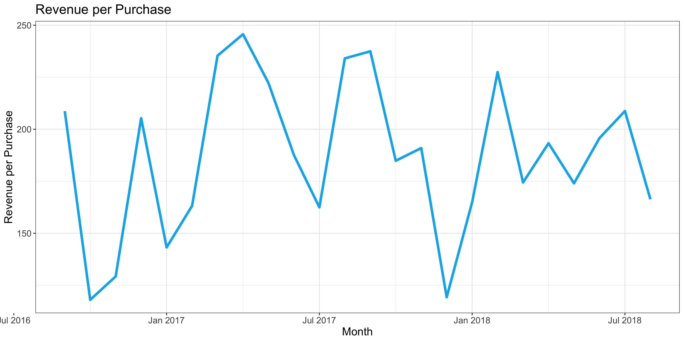
THERE IS NO CLEAR PATTERN FOR REVENUE PER PURCHASE over the years. Revenue per purchase ranges from $120 to $250.

Slide 29
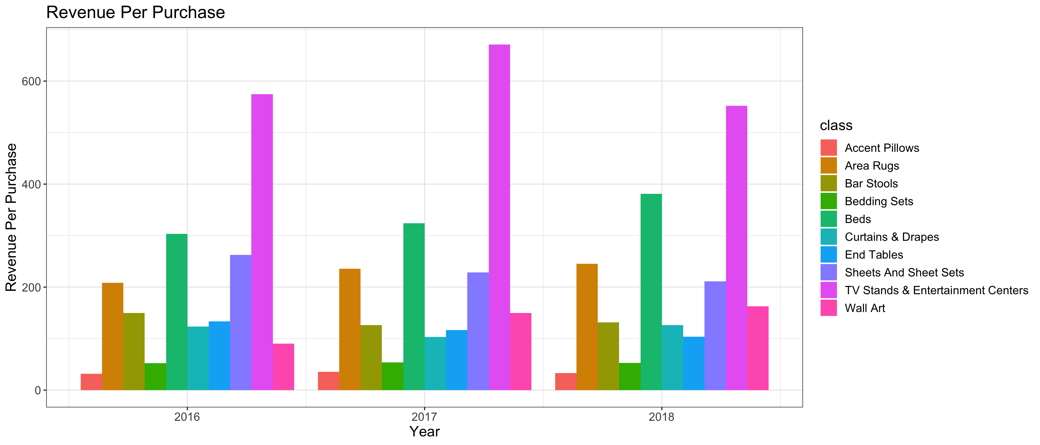
Revenue per purchase trend vary for different sku classes
Accent Pillows, despite having high and growing cart-to-purchase %, has stagnant revenue per purchase during the past 3 years.
Beds and Wall Art has increasing revenue per purchase over the years.
Bar Stools, Sheets and Sheet Sets and TV Stands have decreasing revenue per purchase over the years.
Note: This might not be the full picture for 2016 and 2018 as we only have data from September 2016 to August 2018.

Slide 30
SUMMARY AND RECOMMENDATIONS
On average, SKUs added to cart = 6.06% SKUs viewed. SKUs purchased = 6.85% SKUs added to cart. Both numbers are improving year over year.
Sheets and Sheet Sets and Accent Pillows have the highest view-to-cart and cart-to-purchase ratio. TV Stands, Beds and Area Rugs are highest priced items.
RECOMMENDATIONS:
Wall Art and Area Rugs have high view-to-cart conversion, but low cart-to-purchase conversion. They have relatively high revenue per purchases. For the customers interested in these items, we can show discounts at checkout for these items to improve cart-to-purchase ratio.
Contrarily, Curtains & Drapes is an SKU class with low view-to-cart ratio but high cart-to-purchase ratio. To incentivize the customers interested in this class, we can improve product offerings and quality.
TV Stands & Entertainment Centers and Beds has very low view-to-cart ratio, but very high revenue per purchase. This can be a problem in pricing strategies. We can offer discounts or payment schedule options to incentivize interested customers to purchase first and pay later.

Slide 31
APPENDIX

Slide 32
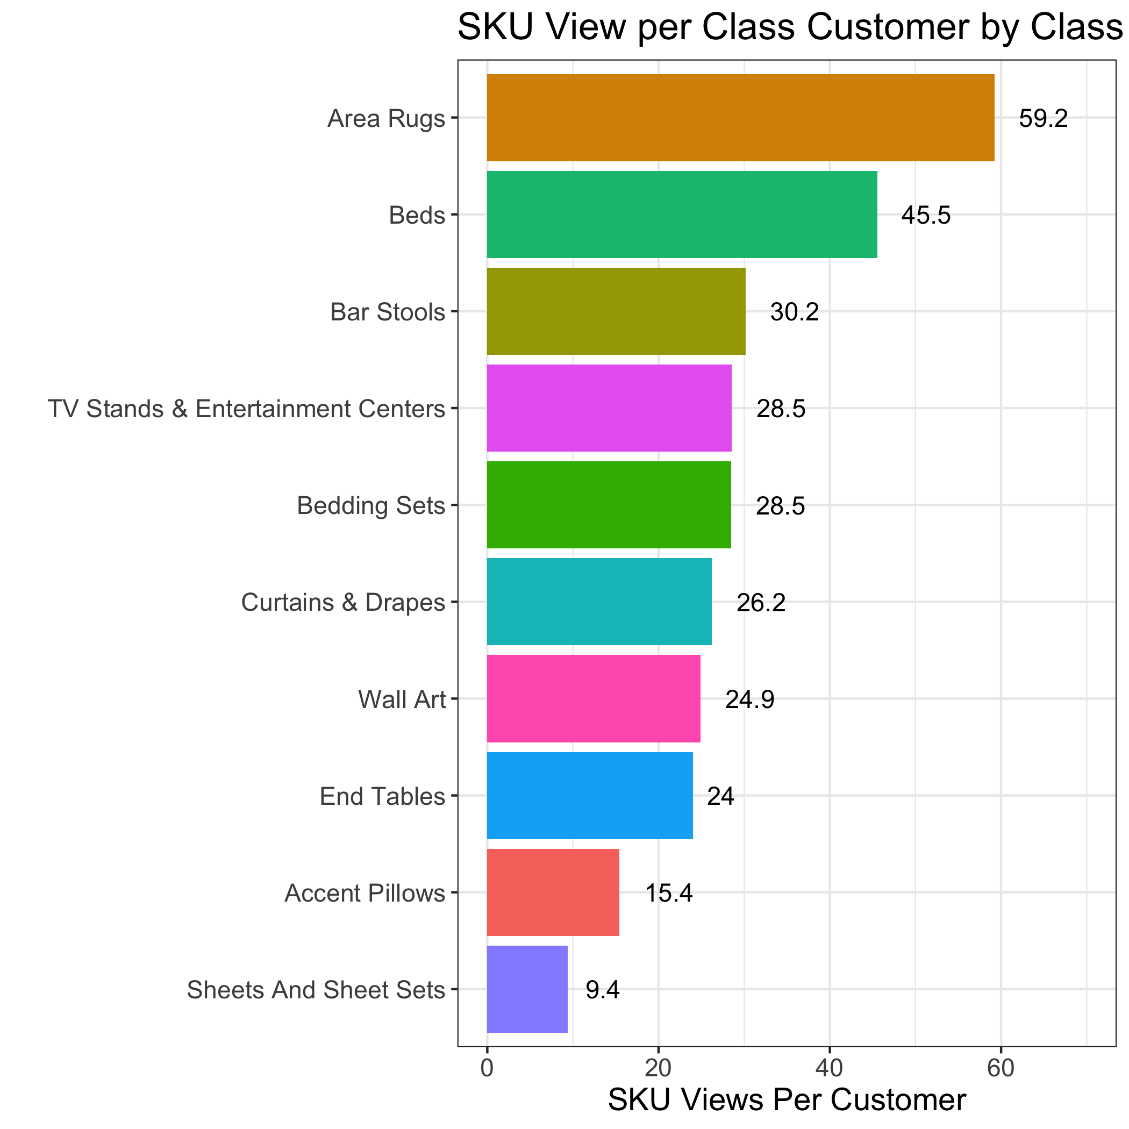
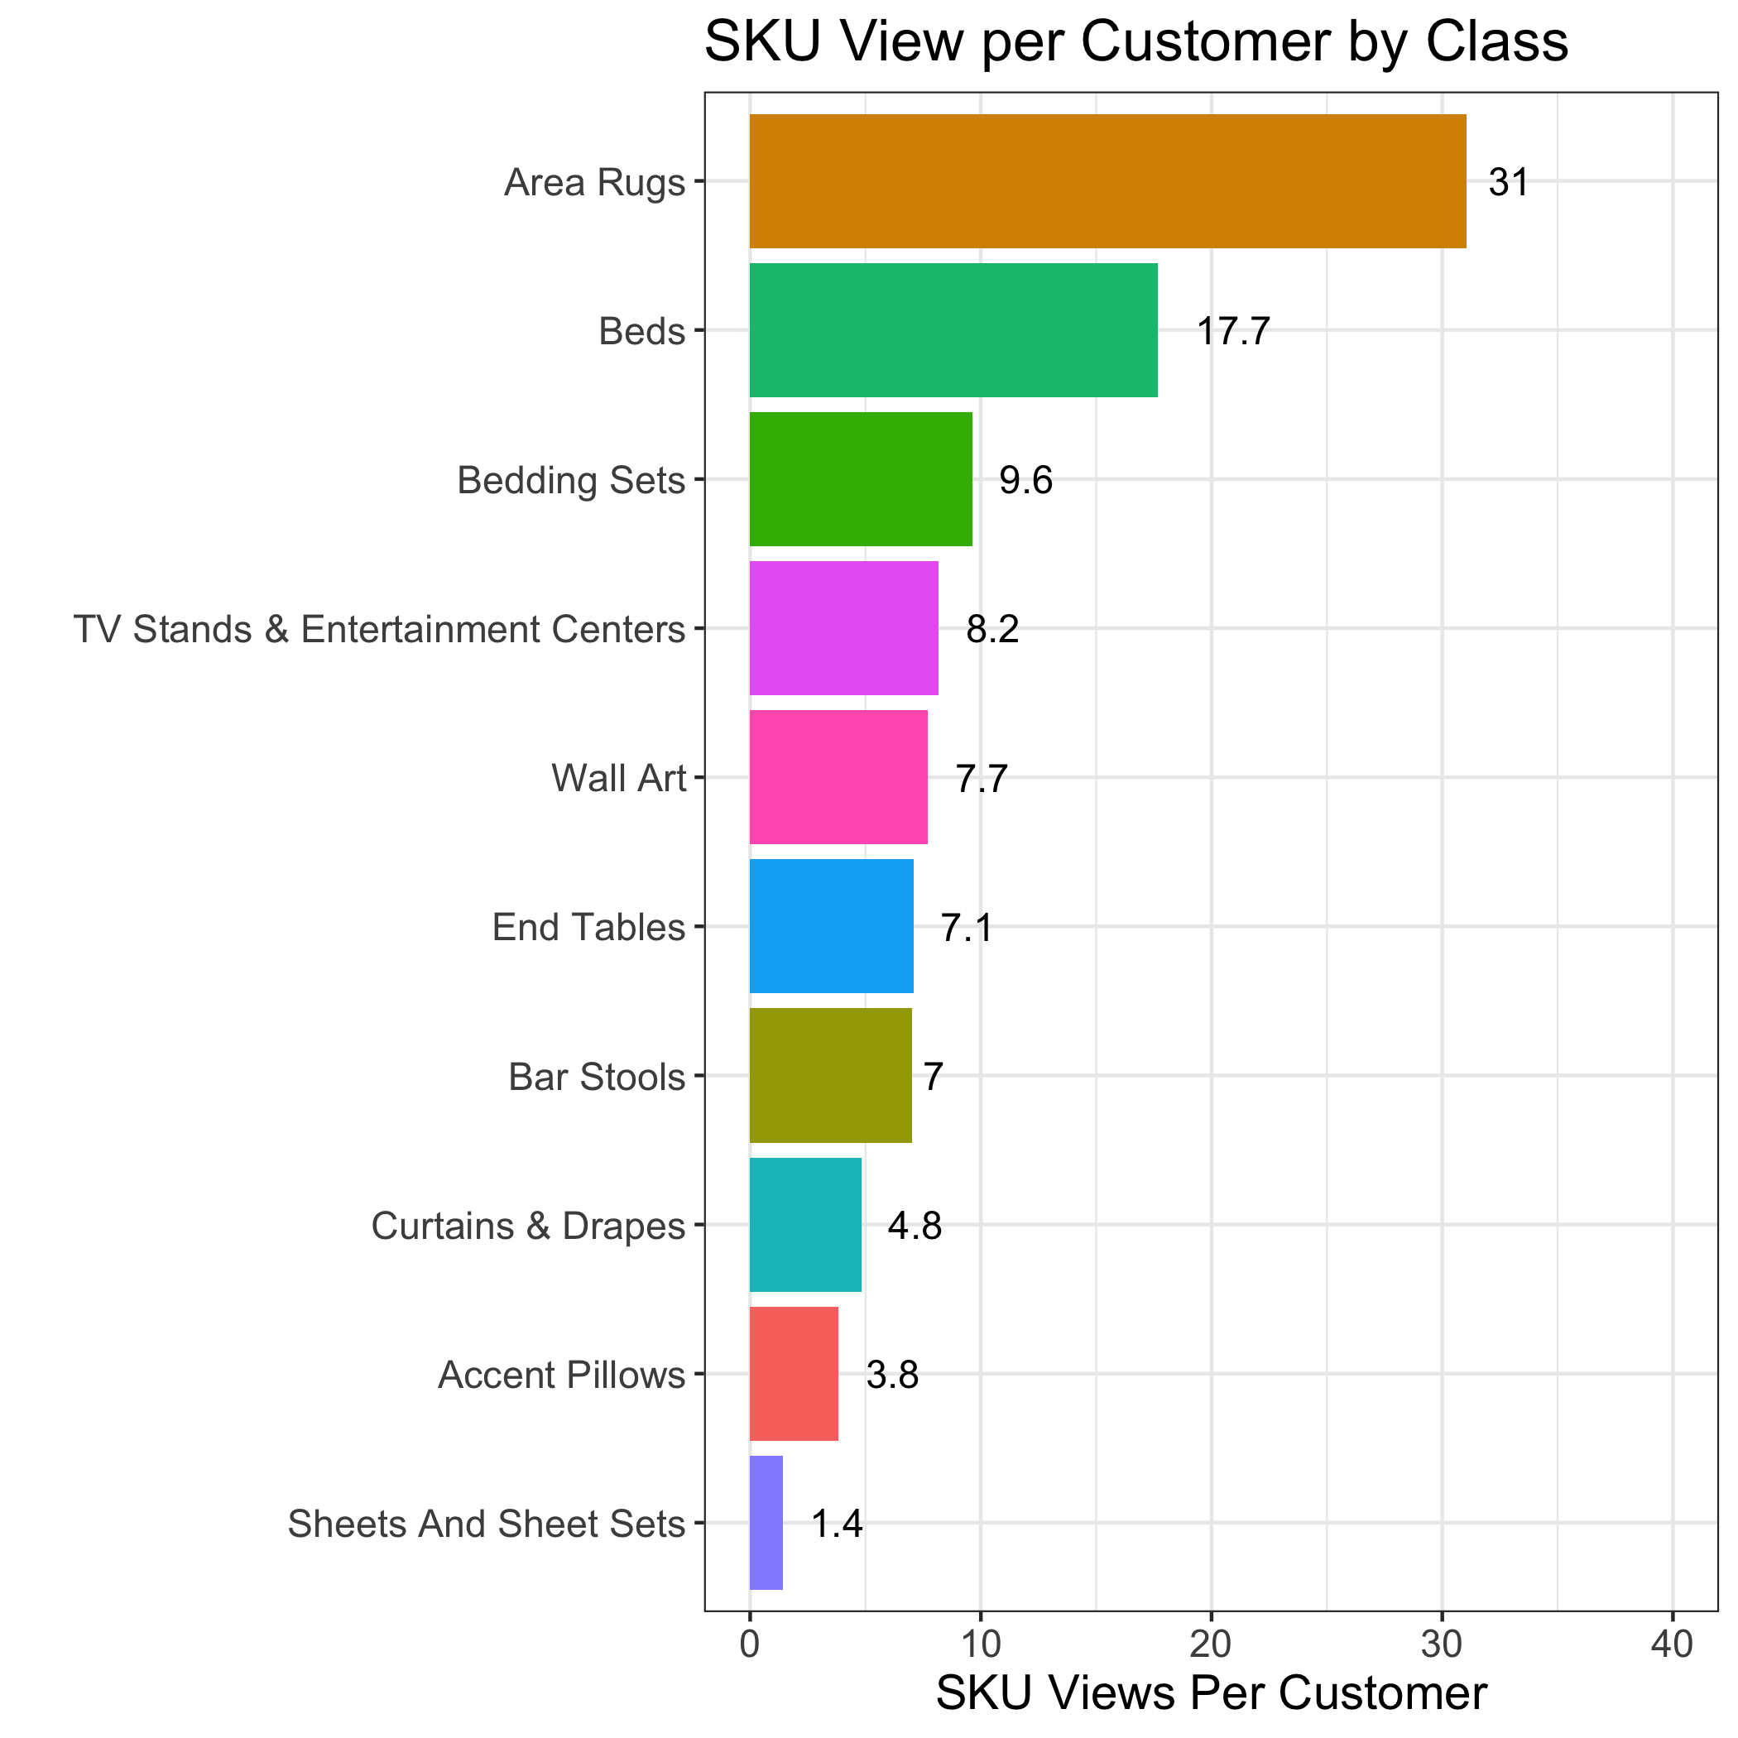
SKU View Per Customer by Class
Area Rugs and Beds have the highest average views per customer. Bar Stools and Curtain & Drapes has very high average views among people who viewed these classes, but with low number of viewers. Accent Pillows and Sheets And Sheet Sets have lowest number of average views, which suggests either low demand or a need for better marketing.
Per Customer numbers are the total number of views for a class divided by all customers (1,383), Per Class Customer numbers are the total number of views for a class divided by the number of viewers for only that class.

Slide 33
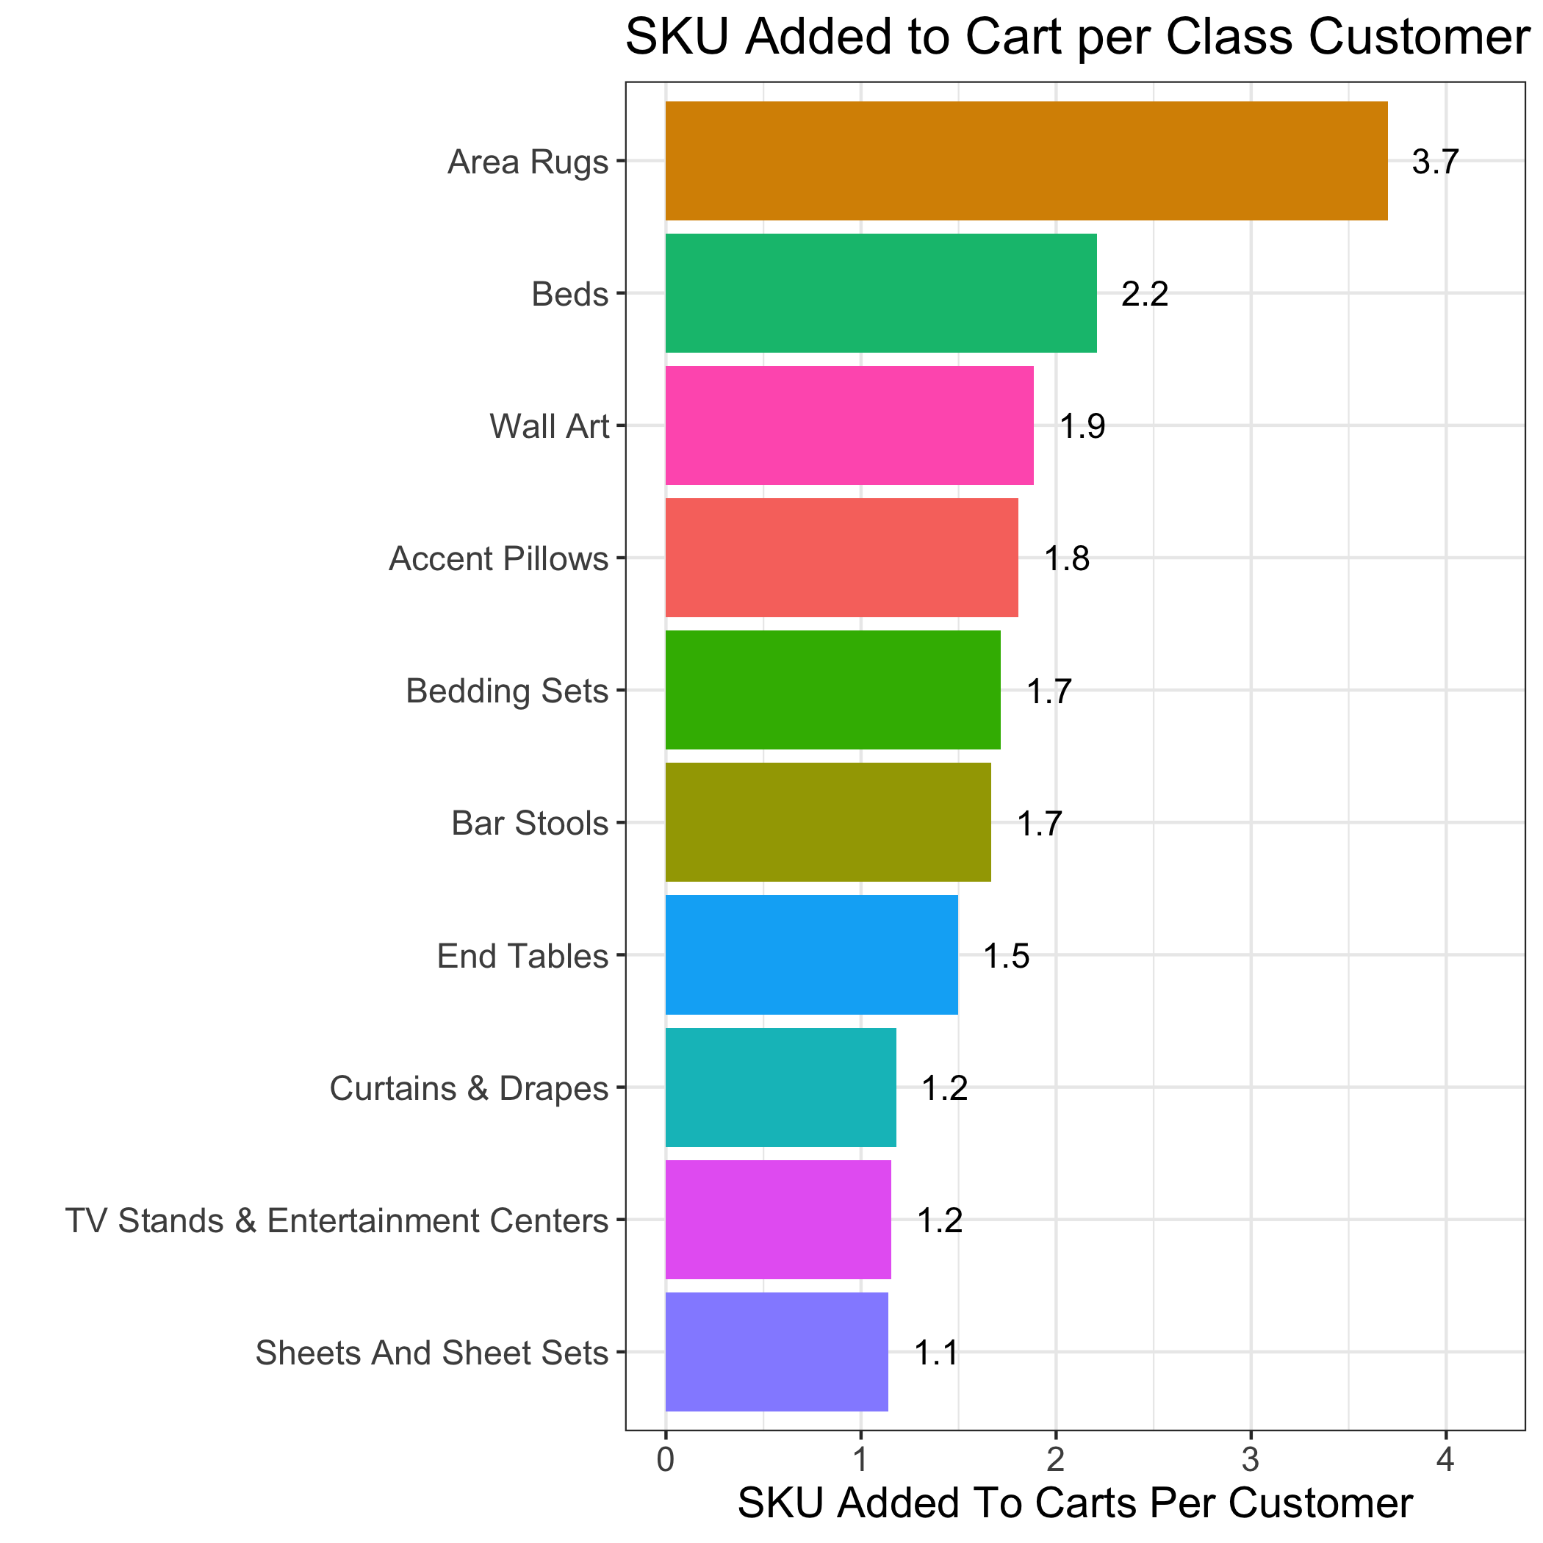
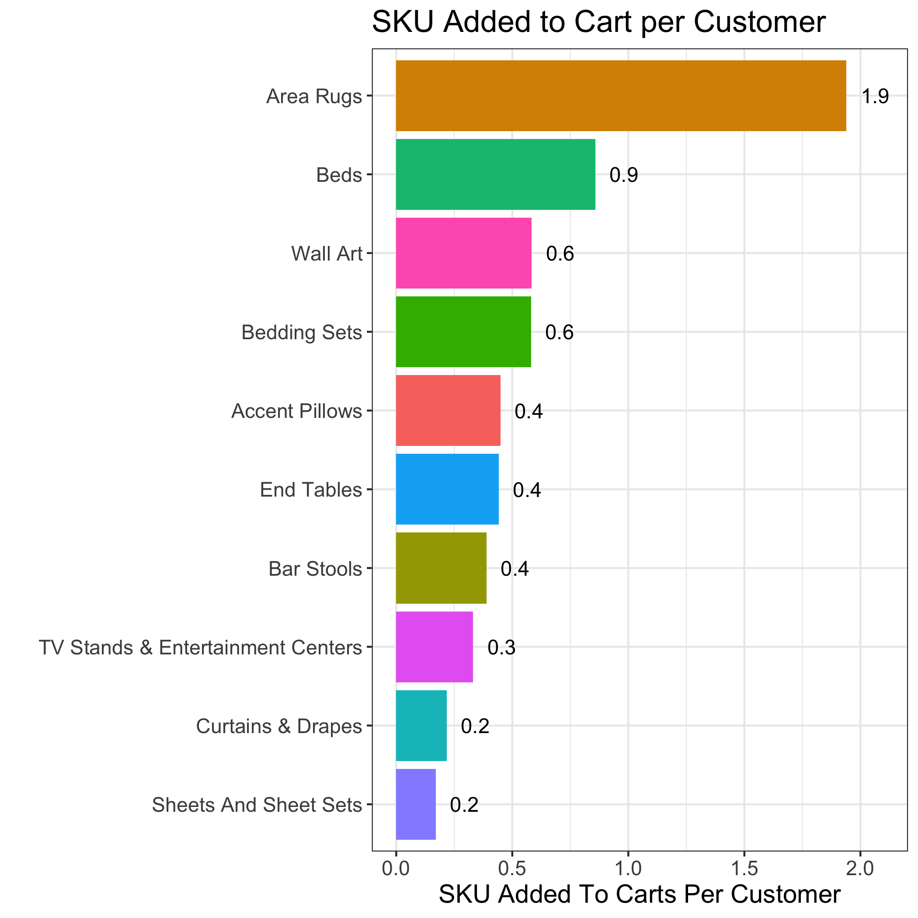
SKU Added to Cart Per Customer by Class
Area Rugs and Beds have the highest number of average items added to cart. Wall Art, Accent Pillows and Bedding Sheets have relatively high number of items added to cart per customer. It is noticeable that Wall Art has low number of average views, but high average number of items added to cart. Sheets and Sheets Set has the lowest number of average items added to cart per customer
Per Customer numbers are the total number of views for a class divided by all customers (1,383), Per Class Customer numbers are the total number of views for a class divided by the number of viewers for only that class.

Slide 34
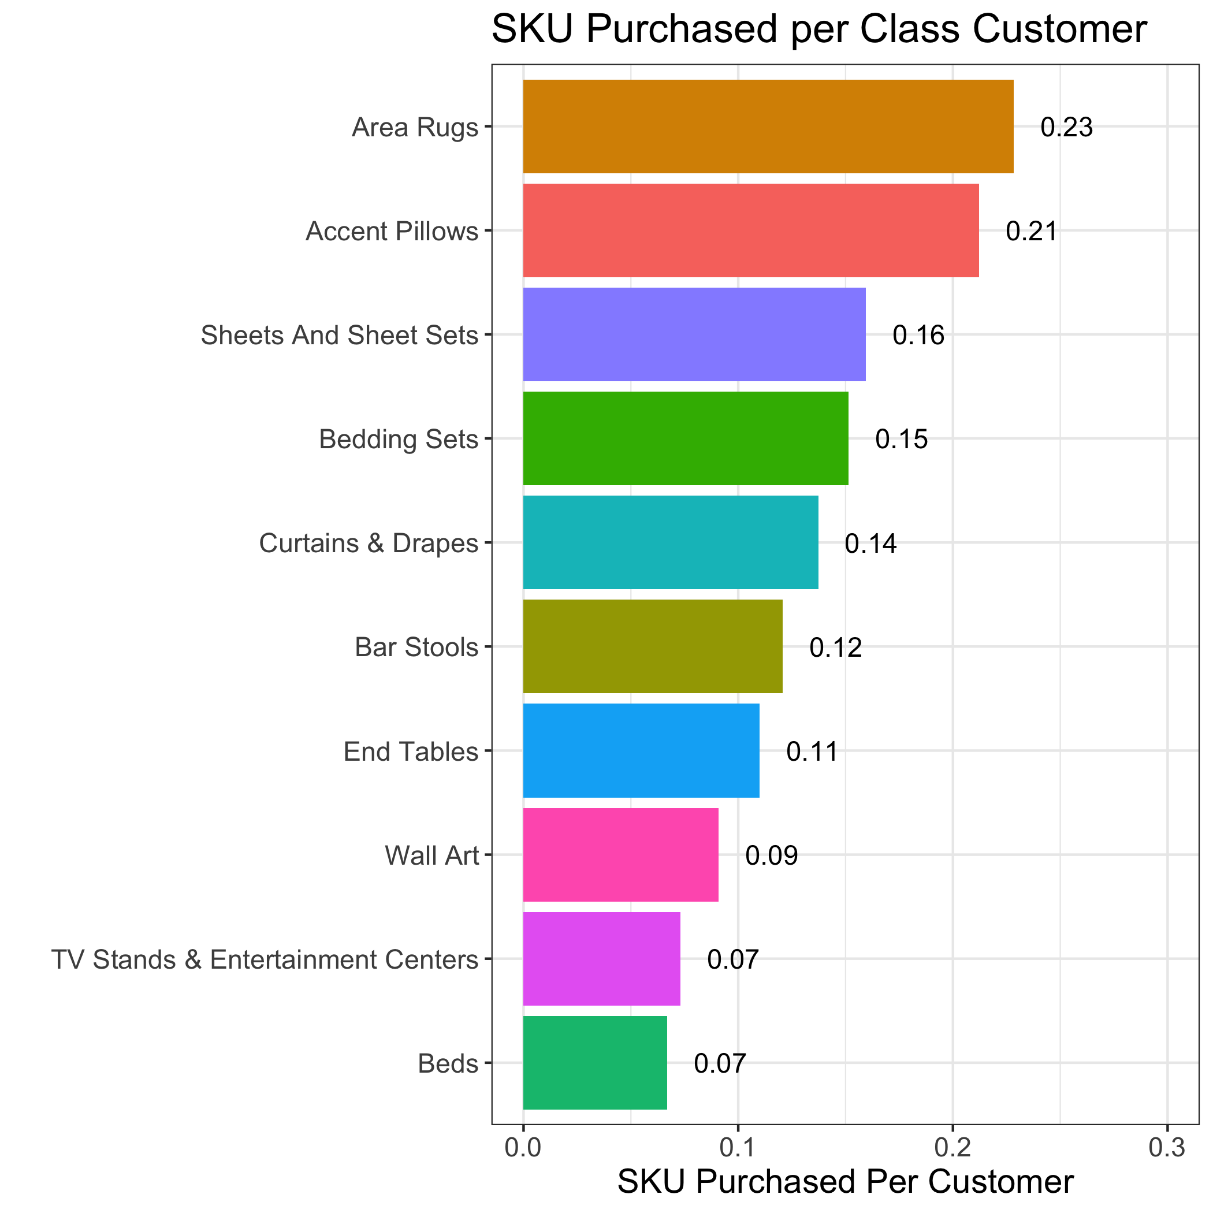
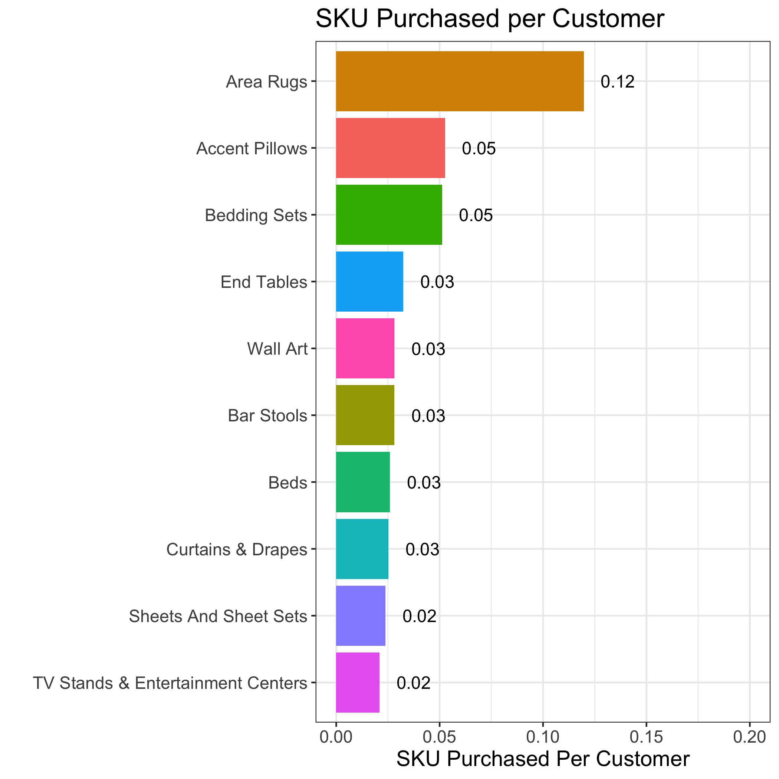
SKU Purchased Per Customer by Class
Area Rugs again has the highest number of items purchased, followed by Accent Pillows and Bedding Sheets. Sheets and Sheet Sets is an interesting case: it has low average # of purchase per customer, but among those who bought this class, they tend to buy a higher number of items. Beds and TV Stands & Entertainment Centers have low number of purchase per customer. This makes intuitive sense as each customer typically only need one item from these classes at a time.
Per Customer numbers are the total number of views for a class divided by all customers (1,383), Per Class Customer numbers are the total number of views for a class divided by the number of viewers for only that class.

Slide 35
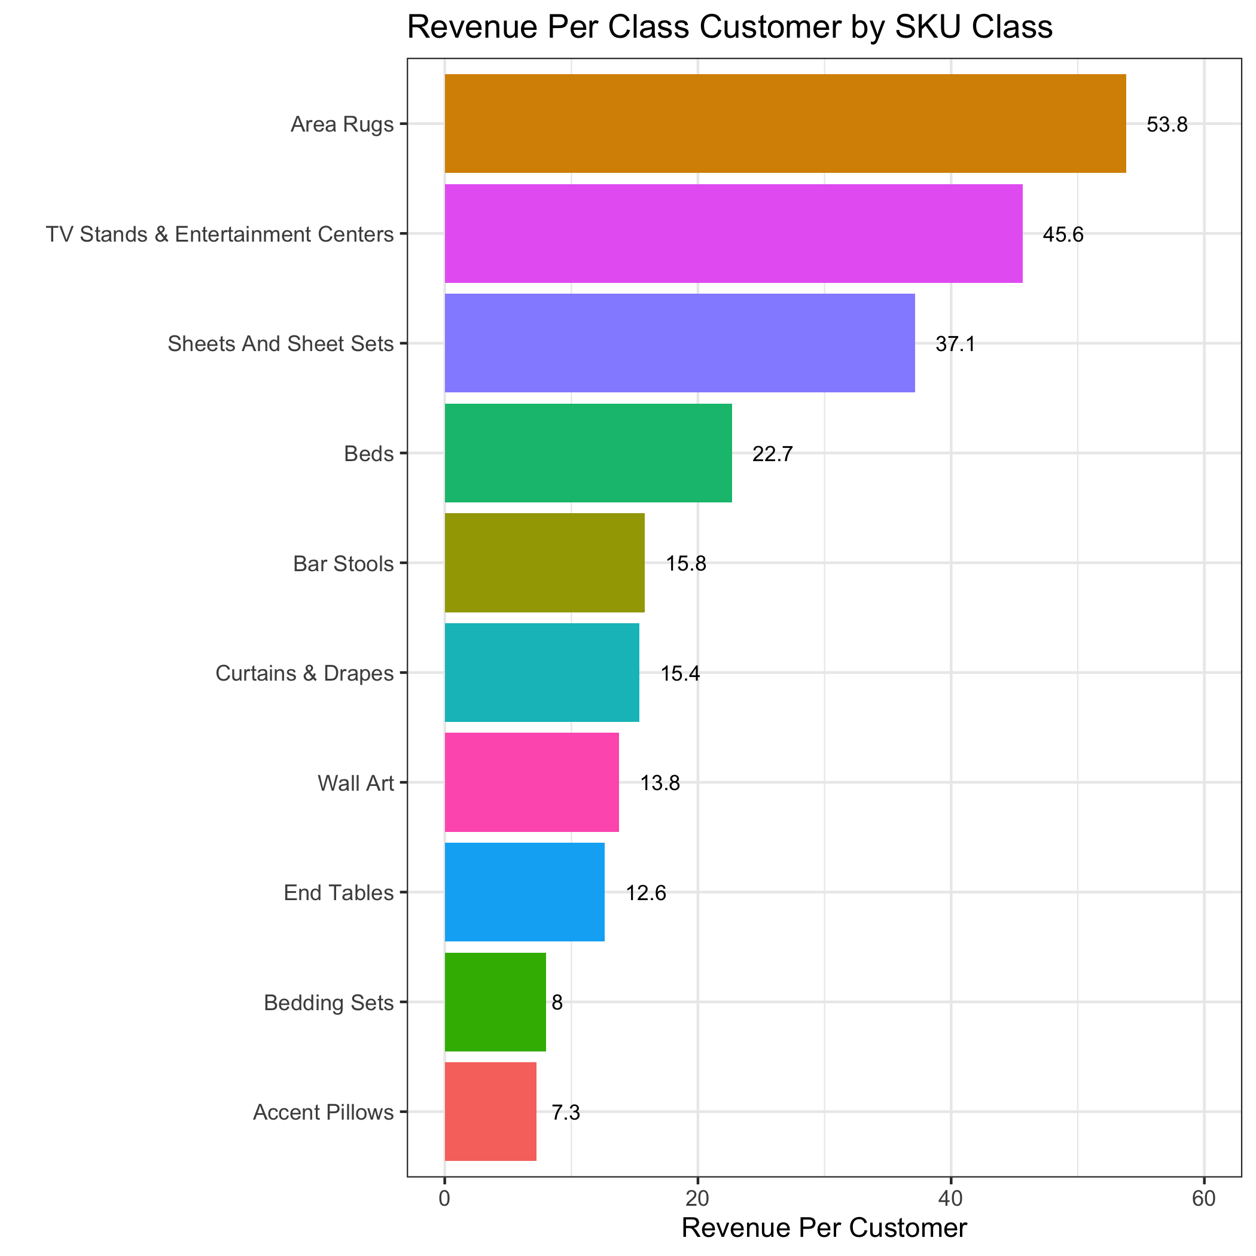
Revenue Per Customer by Class
Area Rugs has the highest revenue per customer. TV Stands & Entertainment Centers has high revenue per customer who purchased this class, but lower revenue per customer overall, suggesting a lower number of customers compared to other classes. Sheets and Sheet Sets has a similar problem. Accent Pillows has very low revenue per customer, suggesting cheap price per item.
Per Customer numbers are the total number of views for a class divided by all customers (1,383), Per Class Customer numbers are the total number of views for a class divided by the number of viewers for only that class.

